Slide 1

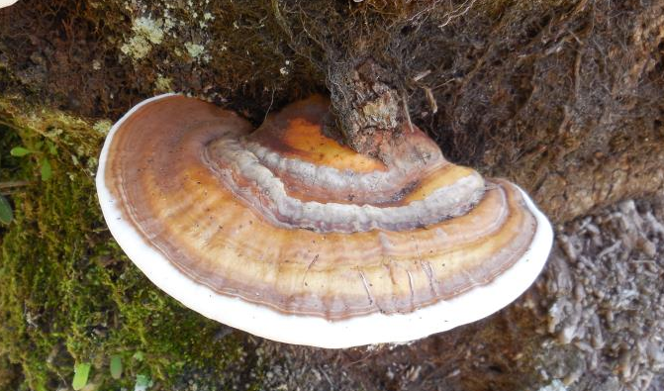
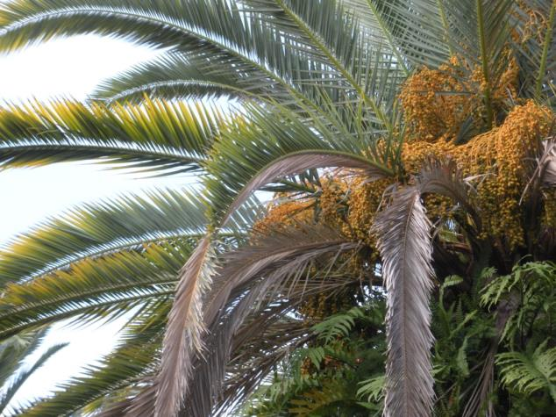
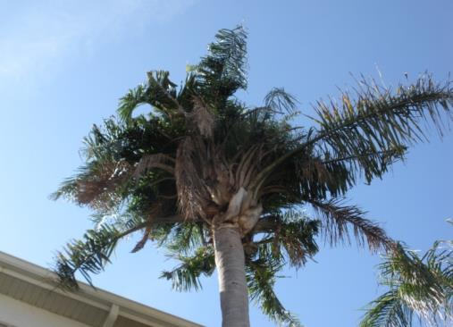
Palm Pests and Disorders

Slide 2
Cal Leggett- Director Of Technical Services
Cal Leggett is our Director of Technical Services. He began his career in greenhouse production of tissue culture liners, followed by experience as a nursery inspector with the Florida Department of Agriculture where he found his passion for the landscape side of the industry. In 2011 he began working for ValleyCrest, now BrightView, and is currently the Director of Technical Services based out of Orlando.
His certifications and licenses include: Certified Arborist, Florida Certified Pest Control Operator – Lawn and Ornamental, Commercial licensed pesticide applicator in Aquatics, Right-of-Way, and Natural Areas.
Education:
Bachelors of Science in Horticulture from Colorado State University
Instructor of Best Management Practices
Experience:
Environmental Specialist at Florida Department of Agriculture and Consumer Services
Greenhouse Grower Coordinator at Agri-Starts, Inc.
Certifications
State of Florida Green Industries Best Management Practice
Florida Turfgrass Association

Slide 3
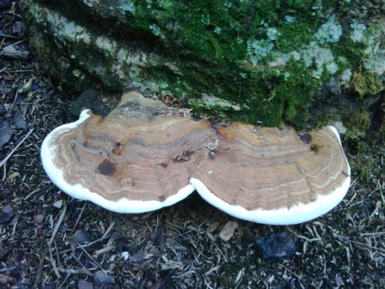
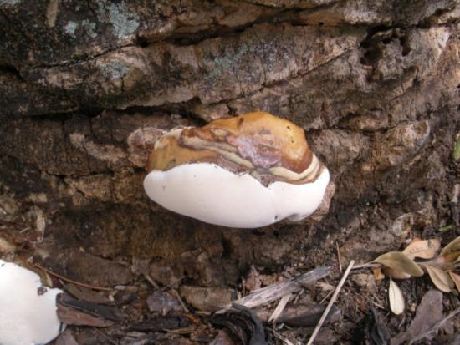
Ganoderma Butt Rot
Hosts: all palm species
Symptoms
  Conks growing on lower 4-5 feet of the trunk
  Rotting in the center of the trunk – visible upon inspection after palm removal
  Always results in the death of the palm
Prevention/Control
  Removal of infected palms, including stumps.
Hazards
  Because of rotting at the base, trees can become structurally unstable
  Clients should be notified that affected trees should be immediately removed

Slide 4
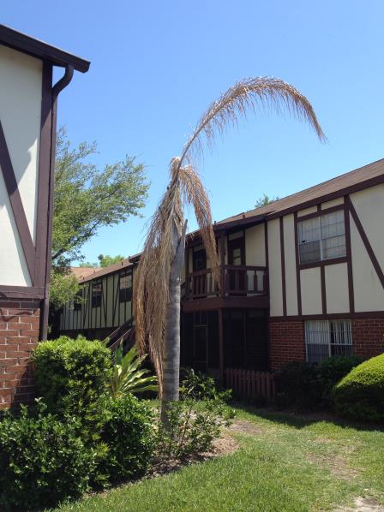
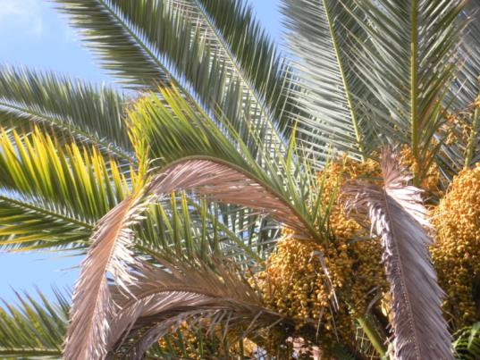
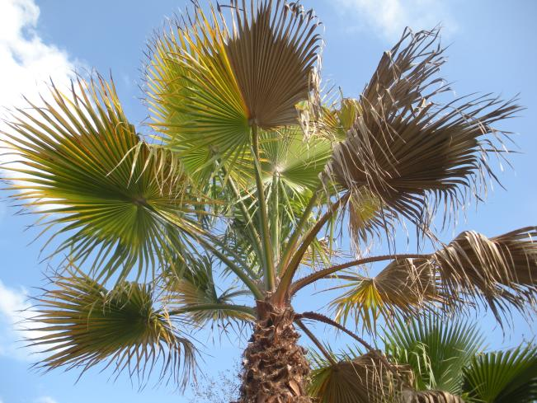
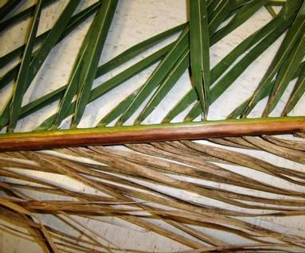
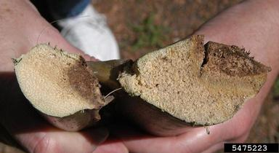
Fusarium Wilt
Hosts: Queen, Washingtonia, and Canary island Date Palms
Symptoms
  Leaves decline from oldest to youngest
  Brown stripe on petiole
  One-sided death of leaf blades
Prevention/Control
  Spores spread by wind, animals, contaminated pruning tools, etc.
  Disinfect pruning tools between trees

Slide 5
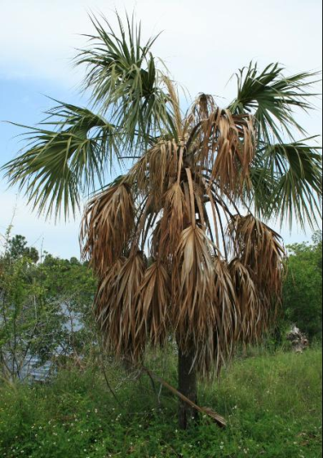
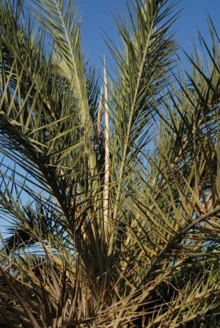
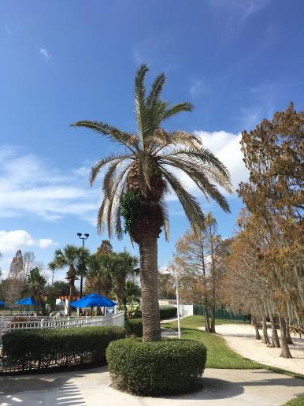
Lethal Bronzing
(Formerly Texas Phoenix Palm Decline)
Hosts: Date, Canary Island Date, Sylvester, Sabal, Christmas, Bismark, Pindo, Carpentaria, Coconut, Chinese Fan, Windmill and Queen Palms
Symptoms
  Sudden fruit drop
  Dead spear leaf
  Large percentage of dead lower leaves
Prevention/Control
  Injections of Oxytetracycline(OTC)
    Must be performed every 3 months for the life of the palm
N. Harrison and M. Elliot, University of Florida - IFAS
N. Harrison and M. Elliot, University of Florida - IFAS

Slide 6
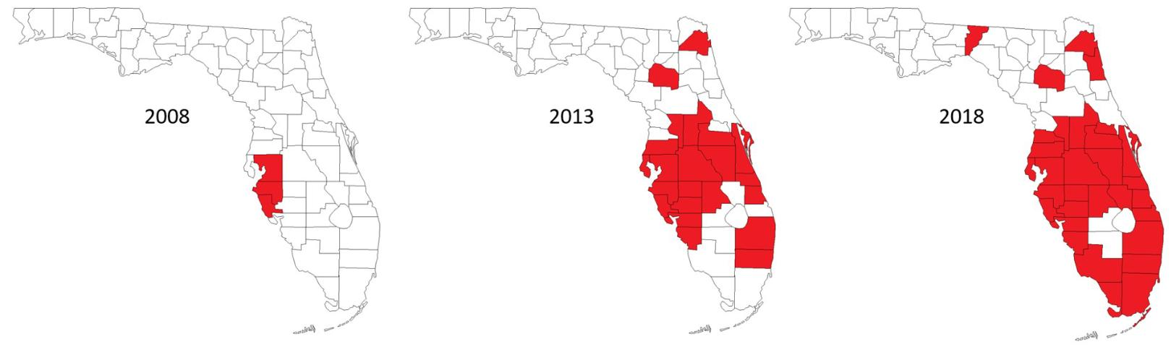
Lethal Bronzing - Distribution

Slide 7
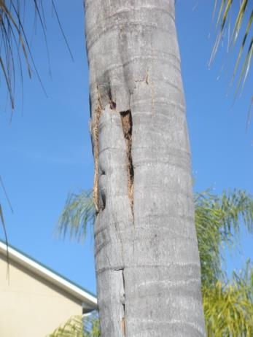
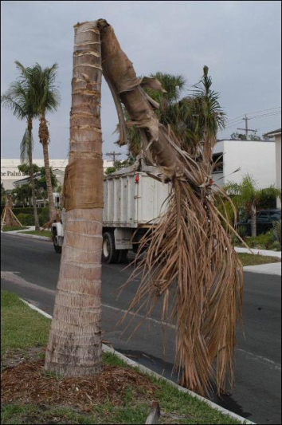
Thielaviopsis Trunk Rot
Affects all palm species
Symptoms
  Trunk folds over or canopy falls out of tree
  Stem “bleeding”
Prevention/Control
  Disease enters through wounds in trunk
  Don’t use tree climbing spikes
  Attach holiday lights, signs, light fixtures, etc. with zip ties instead of screws or staples
M. Elliot, University of Florida - IFAS

Slide 8
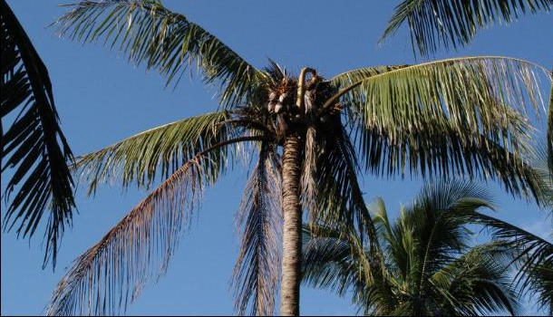
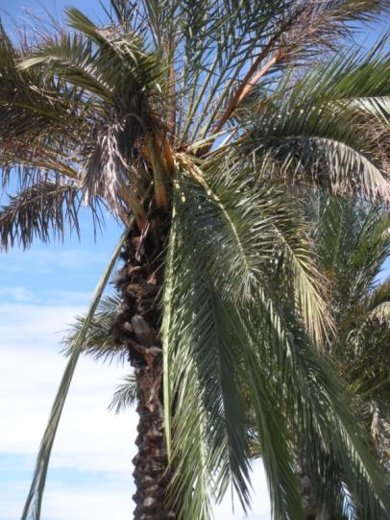
Bud Rot
Hosts: all palm species
Symptoms
  Death of spear leaf and surrounding leaves
  Collapsed canopy
Prevention/Control
  Difficult to prevent in the landscape
    Disease starts on the spear leaf and moves in the bud
    Short window for treatment
M. Elliot, University of Florida - IFAS

Slide 9
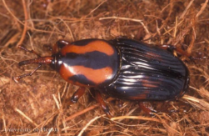
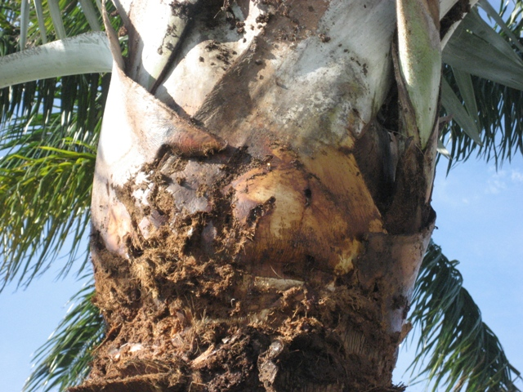
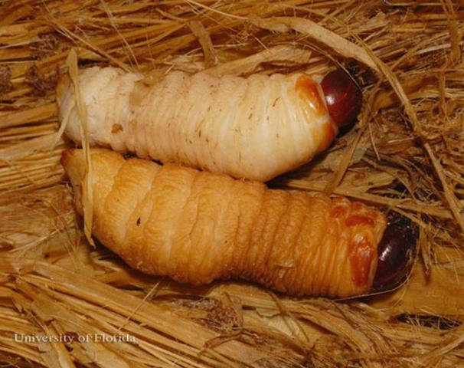
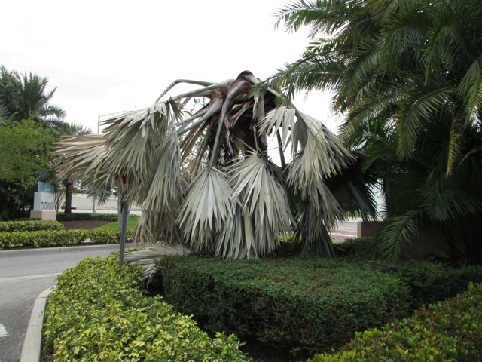
Palmetto Weevil
Hosts: Date (Medjool), Canary Island Date, Washingtonia, Bismark, and Sabal palms
Symptoms
  Collapse of almost all leaves in canopy
  Death of spear leaf and surrounding leaves
Prevention/Control
  Do not remove green leaves – weevils are attracted to wounds
  Bud & Soil drench with systemic insecticide – Mallet or Safari

Slide 10
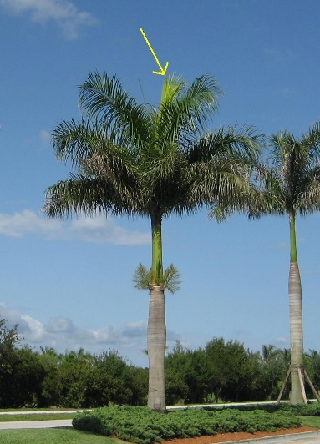
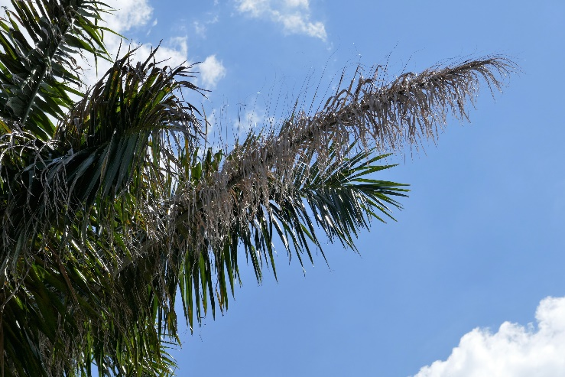
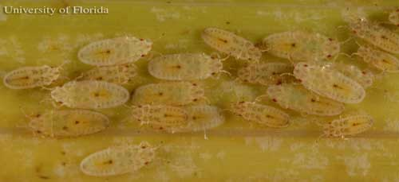
Royal Palm Bug
Host: Royal Palm
Symptoms
  Feed on young, freshly opened leaves causing yellowing
  Damage results in a gray and tattered appearance of fronds as they mature.
Prevention/Control
  Soil drench with systemic insecticide in the spring to control infestations before they reach damaging levels

Slide 11
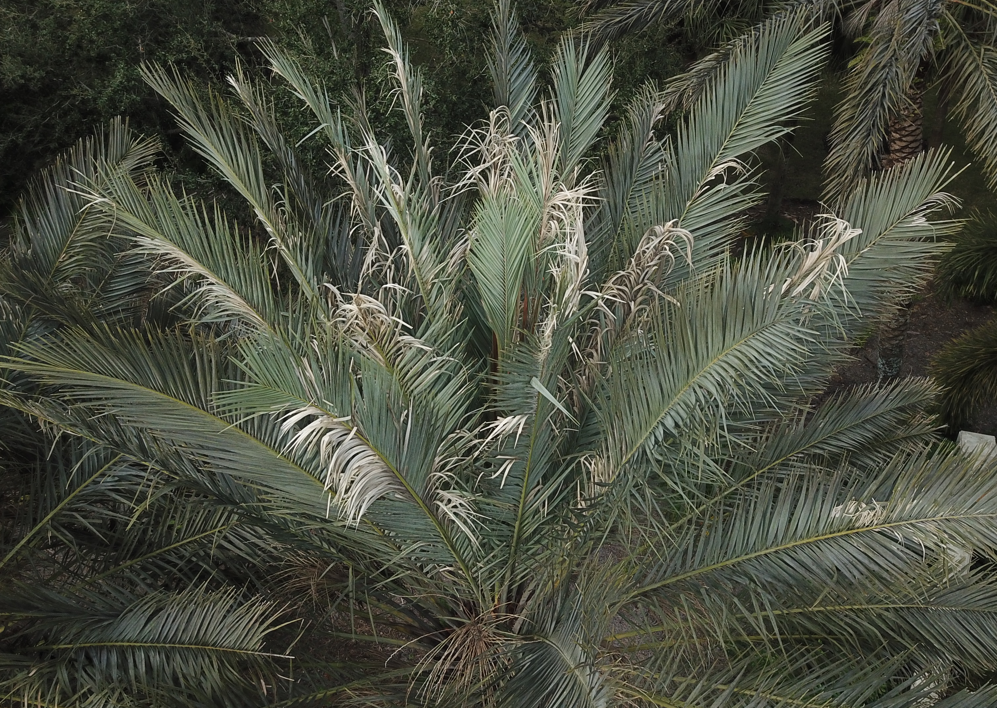
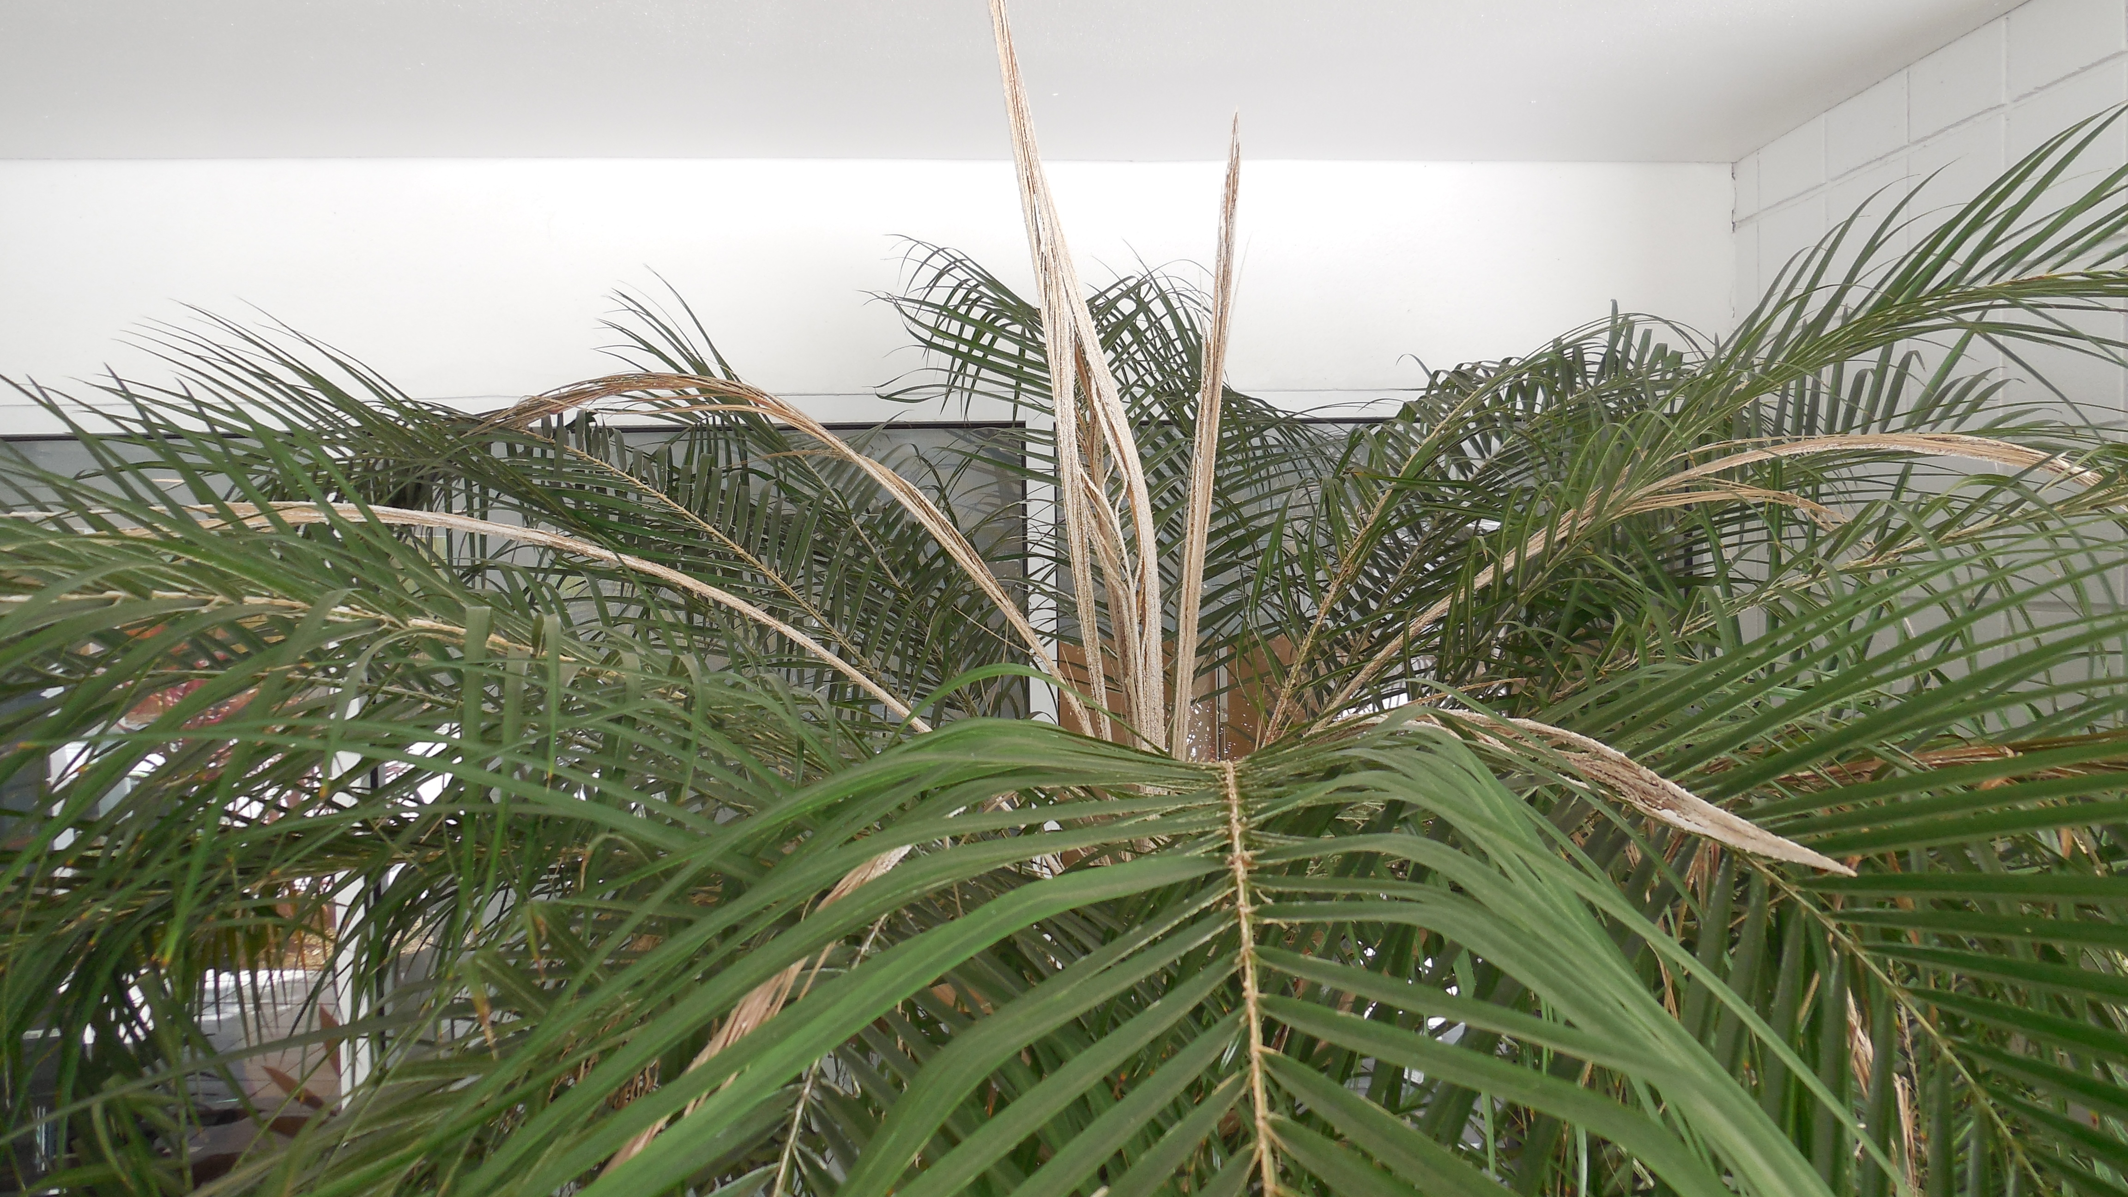
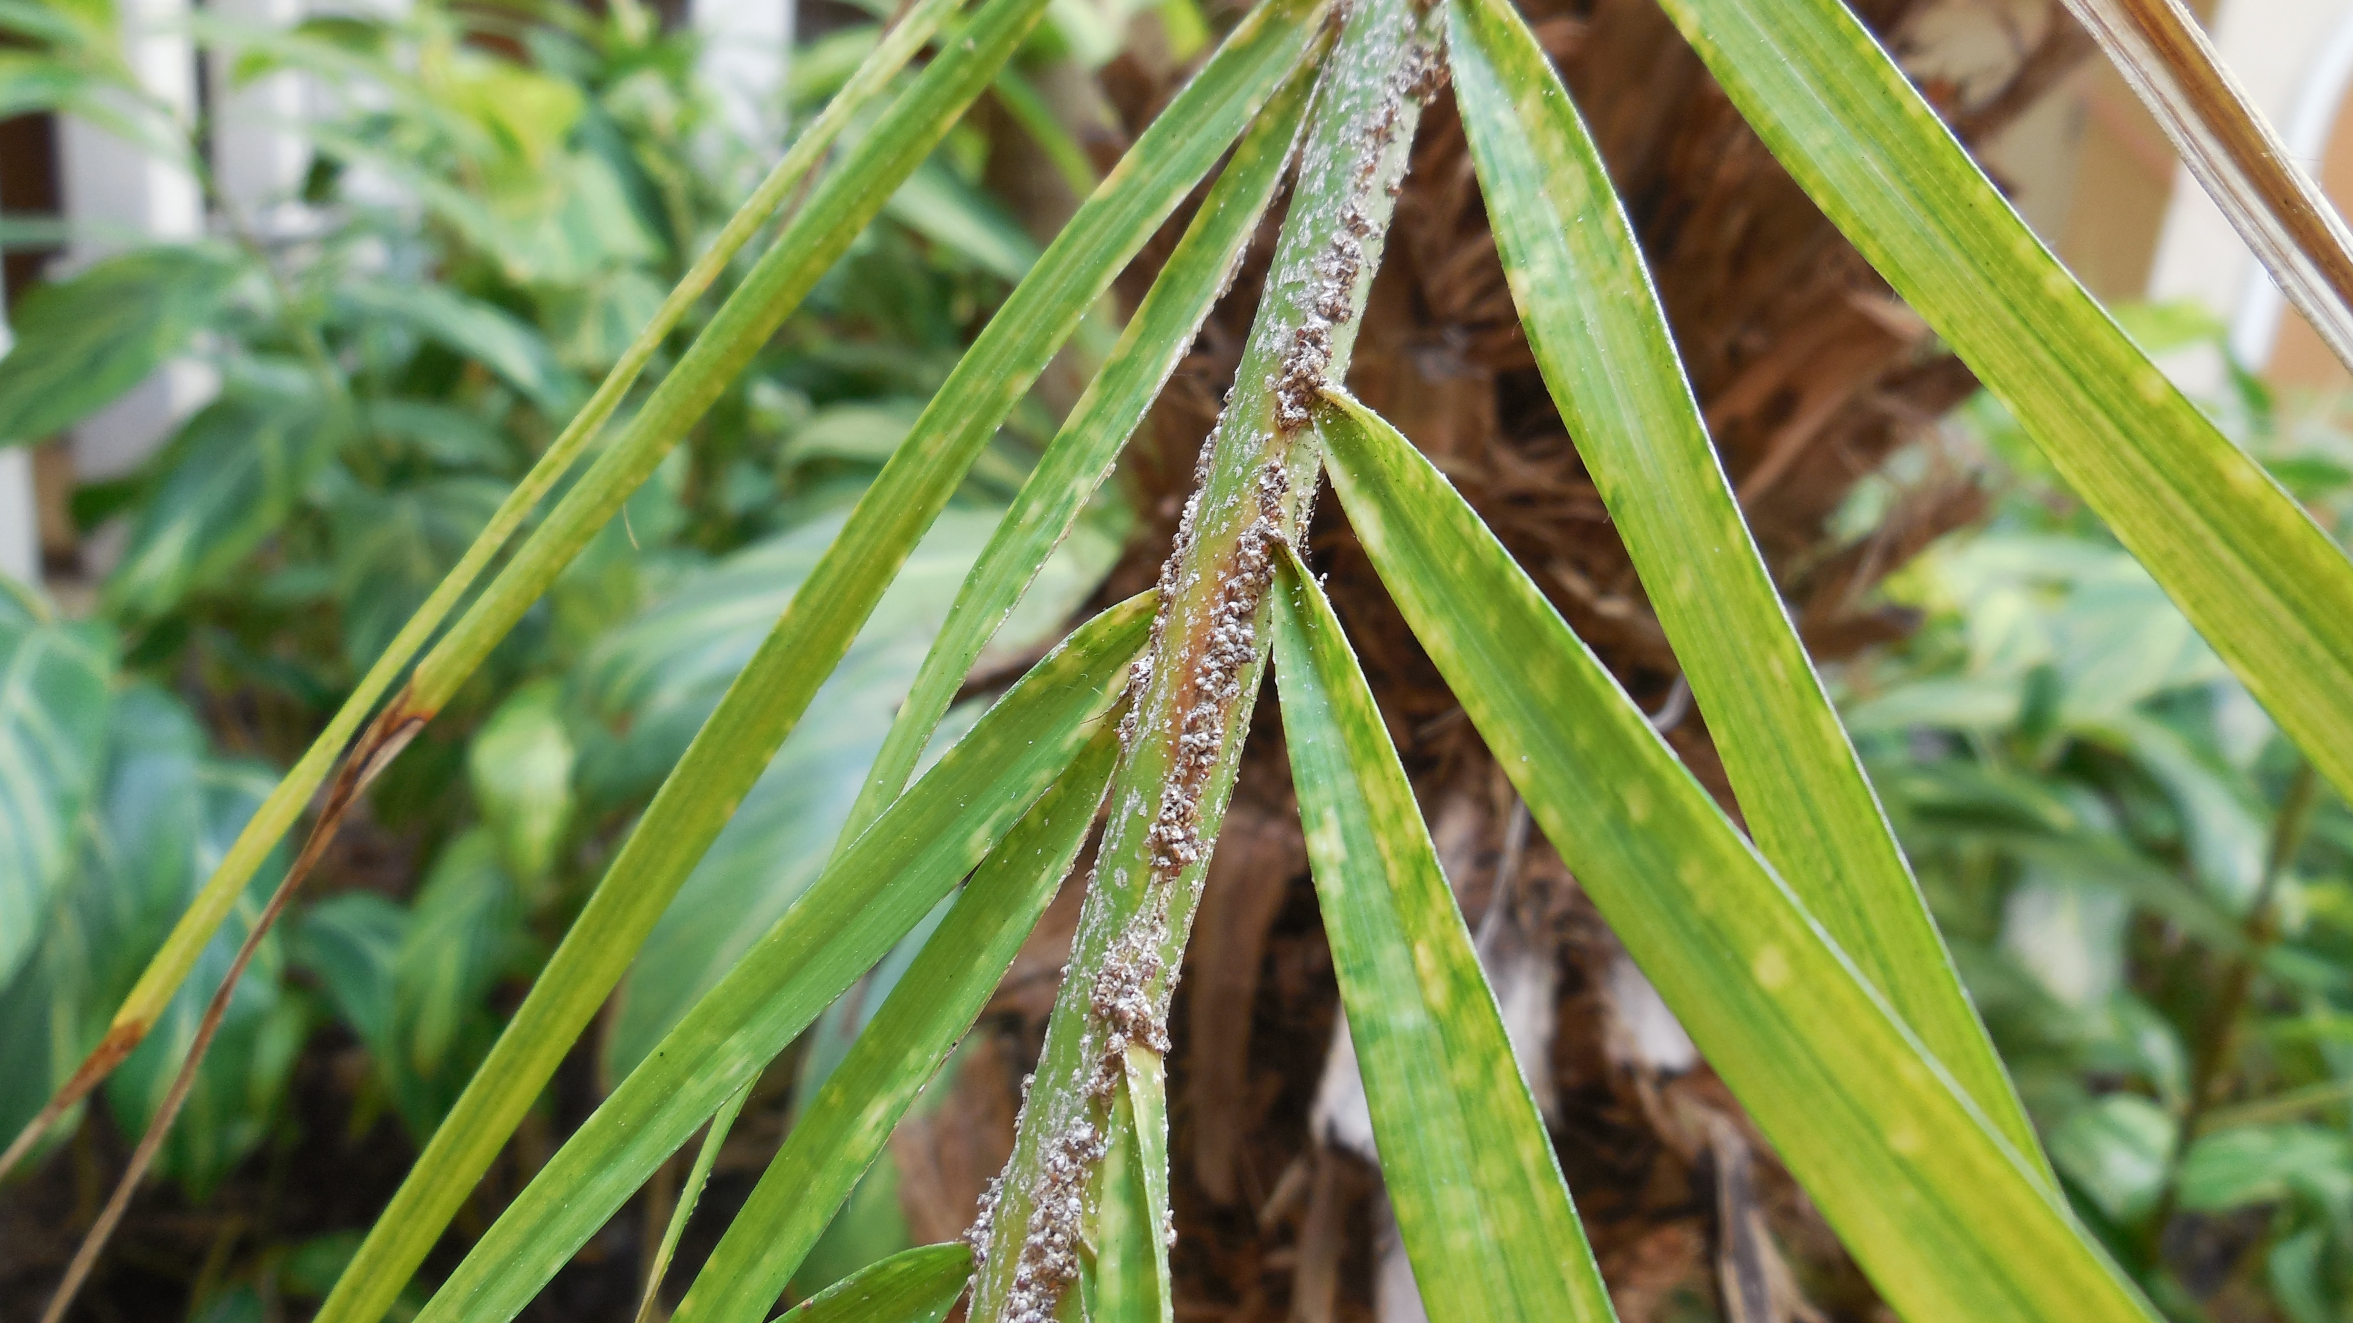
Red Date Scale
Hosts: Date (Medjool), Canary Island Date, Sylvester, and Pygmy Date palms
Symptoms
  Irregular sections of dead, tan leaflets on fronds
  Infestations on Pygmy Date palms can result in death of the spear and young fronds
Prevention/Control
  Soil drench with systemic insecticide when symptoms are visible.

Slide 12
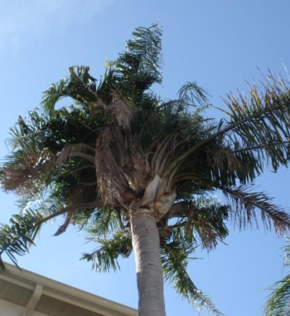
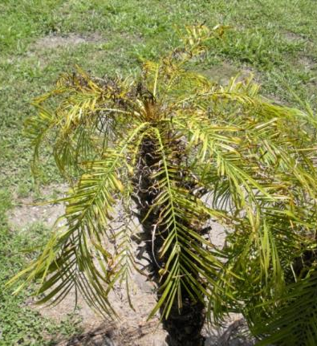
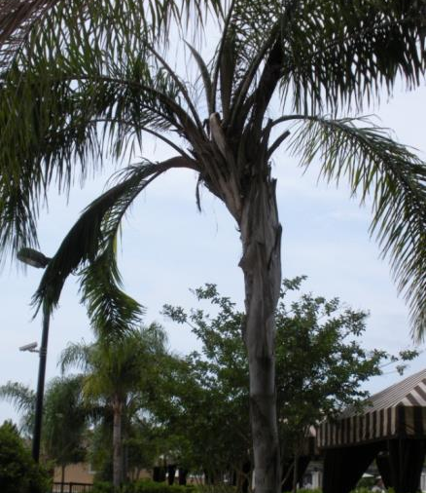
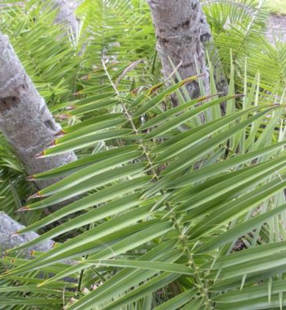
Nutrient Deficiencies

Slide 13
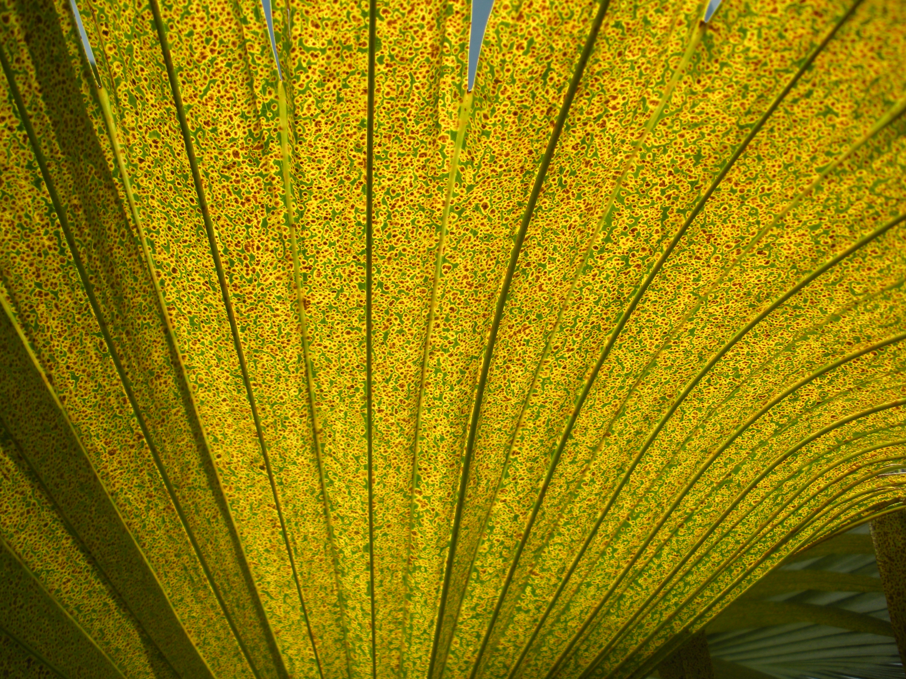
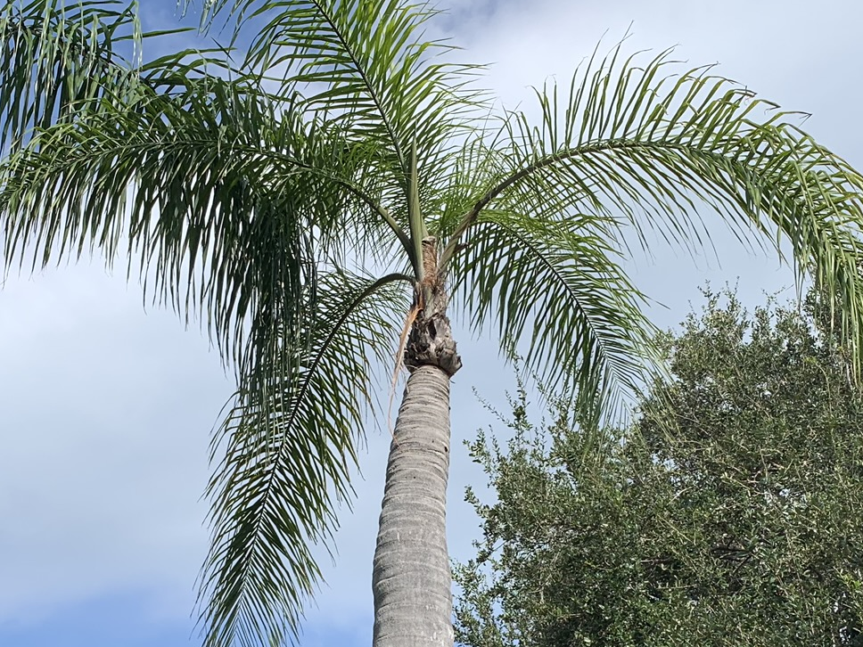
Potassium (K)
Symptoms
  Occurs on oldest fronds first
  Translucent yellow spotting
  Necrosis on leaf tips
  ‘pencil-pointing’ of trunk
Treatment
  Apply 0-0-20 K-Mag(3 lbs) and 8-2-12(3-5lbs) every 3 months for one year
  Continue with 8-2-12 after 1 year

Slide 14
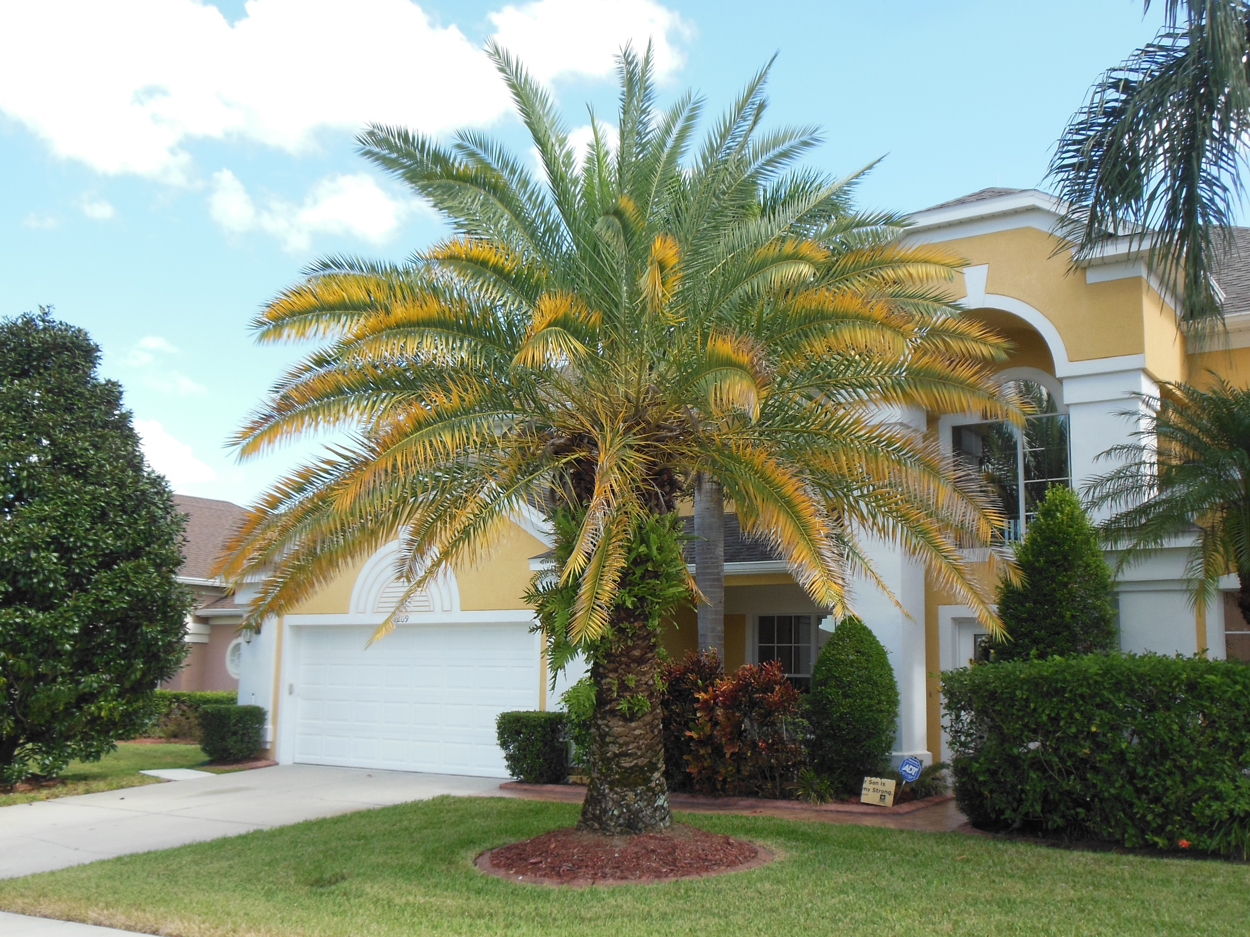
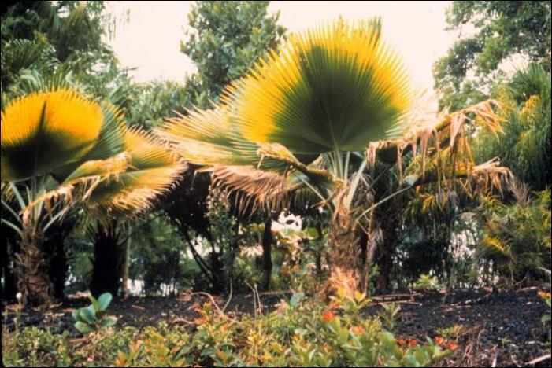
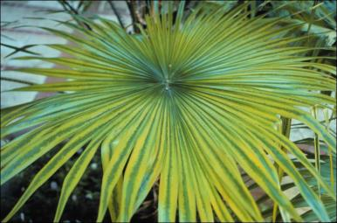
Magnesium (Mg)
Symptoms
  Occurs on oldest fronds first
  Margins of fronds turn yellow while middle remains green
  Often occurs along with K deficiency
Treatment
  Apply 0-0-20 K-Mag(3lbs) and 8-2-12(3-5lbs) every 3 months for 6 months
  Continue with 8-2-12 after 1 year

Slide 15
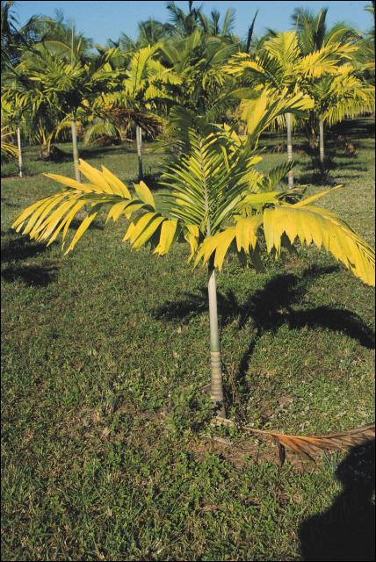
Nitrogen (N)
Symptoms
  Extremely rare in landscape palms
    Most commonly seen on Areca and Majesty palms in the landscape
  Begins with overall yellowing of the oldest fronds, and progresses until the entire canopy is chlorotic
Treatment
  8-2-12 applications every 3 months

Slide 16

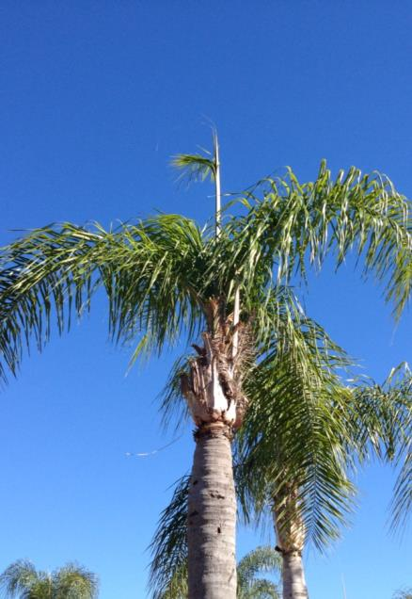
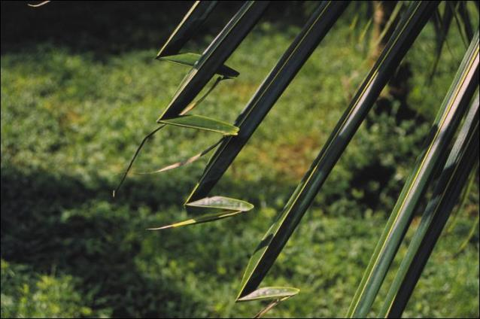
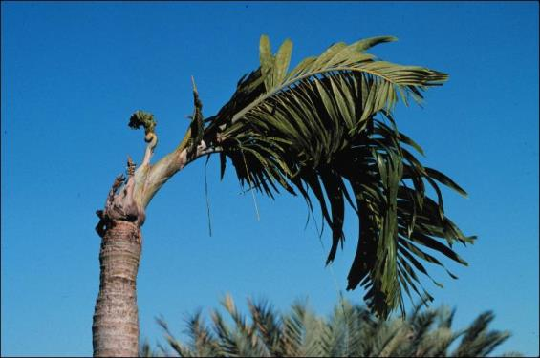
Boron (B)

Slide 17
Boron coninued
Symptoms
  Occurs on new fronds
  Most common symptom is the spear leaf failing to open correctly, sometimes with a ‘flag” at the tip where the frond has slightly opened
  Necrotic leaf tips in an inverted “V” pattern
    Occurs at the tip, not the base (important to distinguish between Mn deficiency)
  “Hooking” of leaflet tips
  Severe deficiency can cause the trunk to ben and grow at an angle
Treatment
  1/3 cup Solubor every 6 months only when symptoms are present

Slide 18
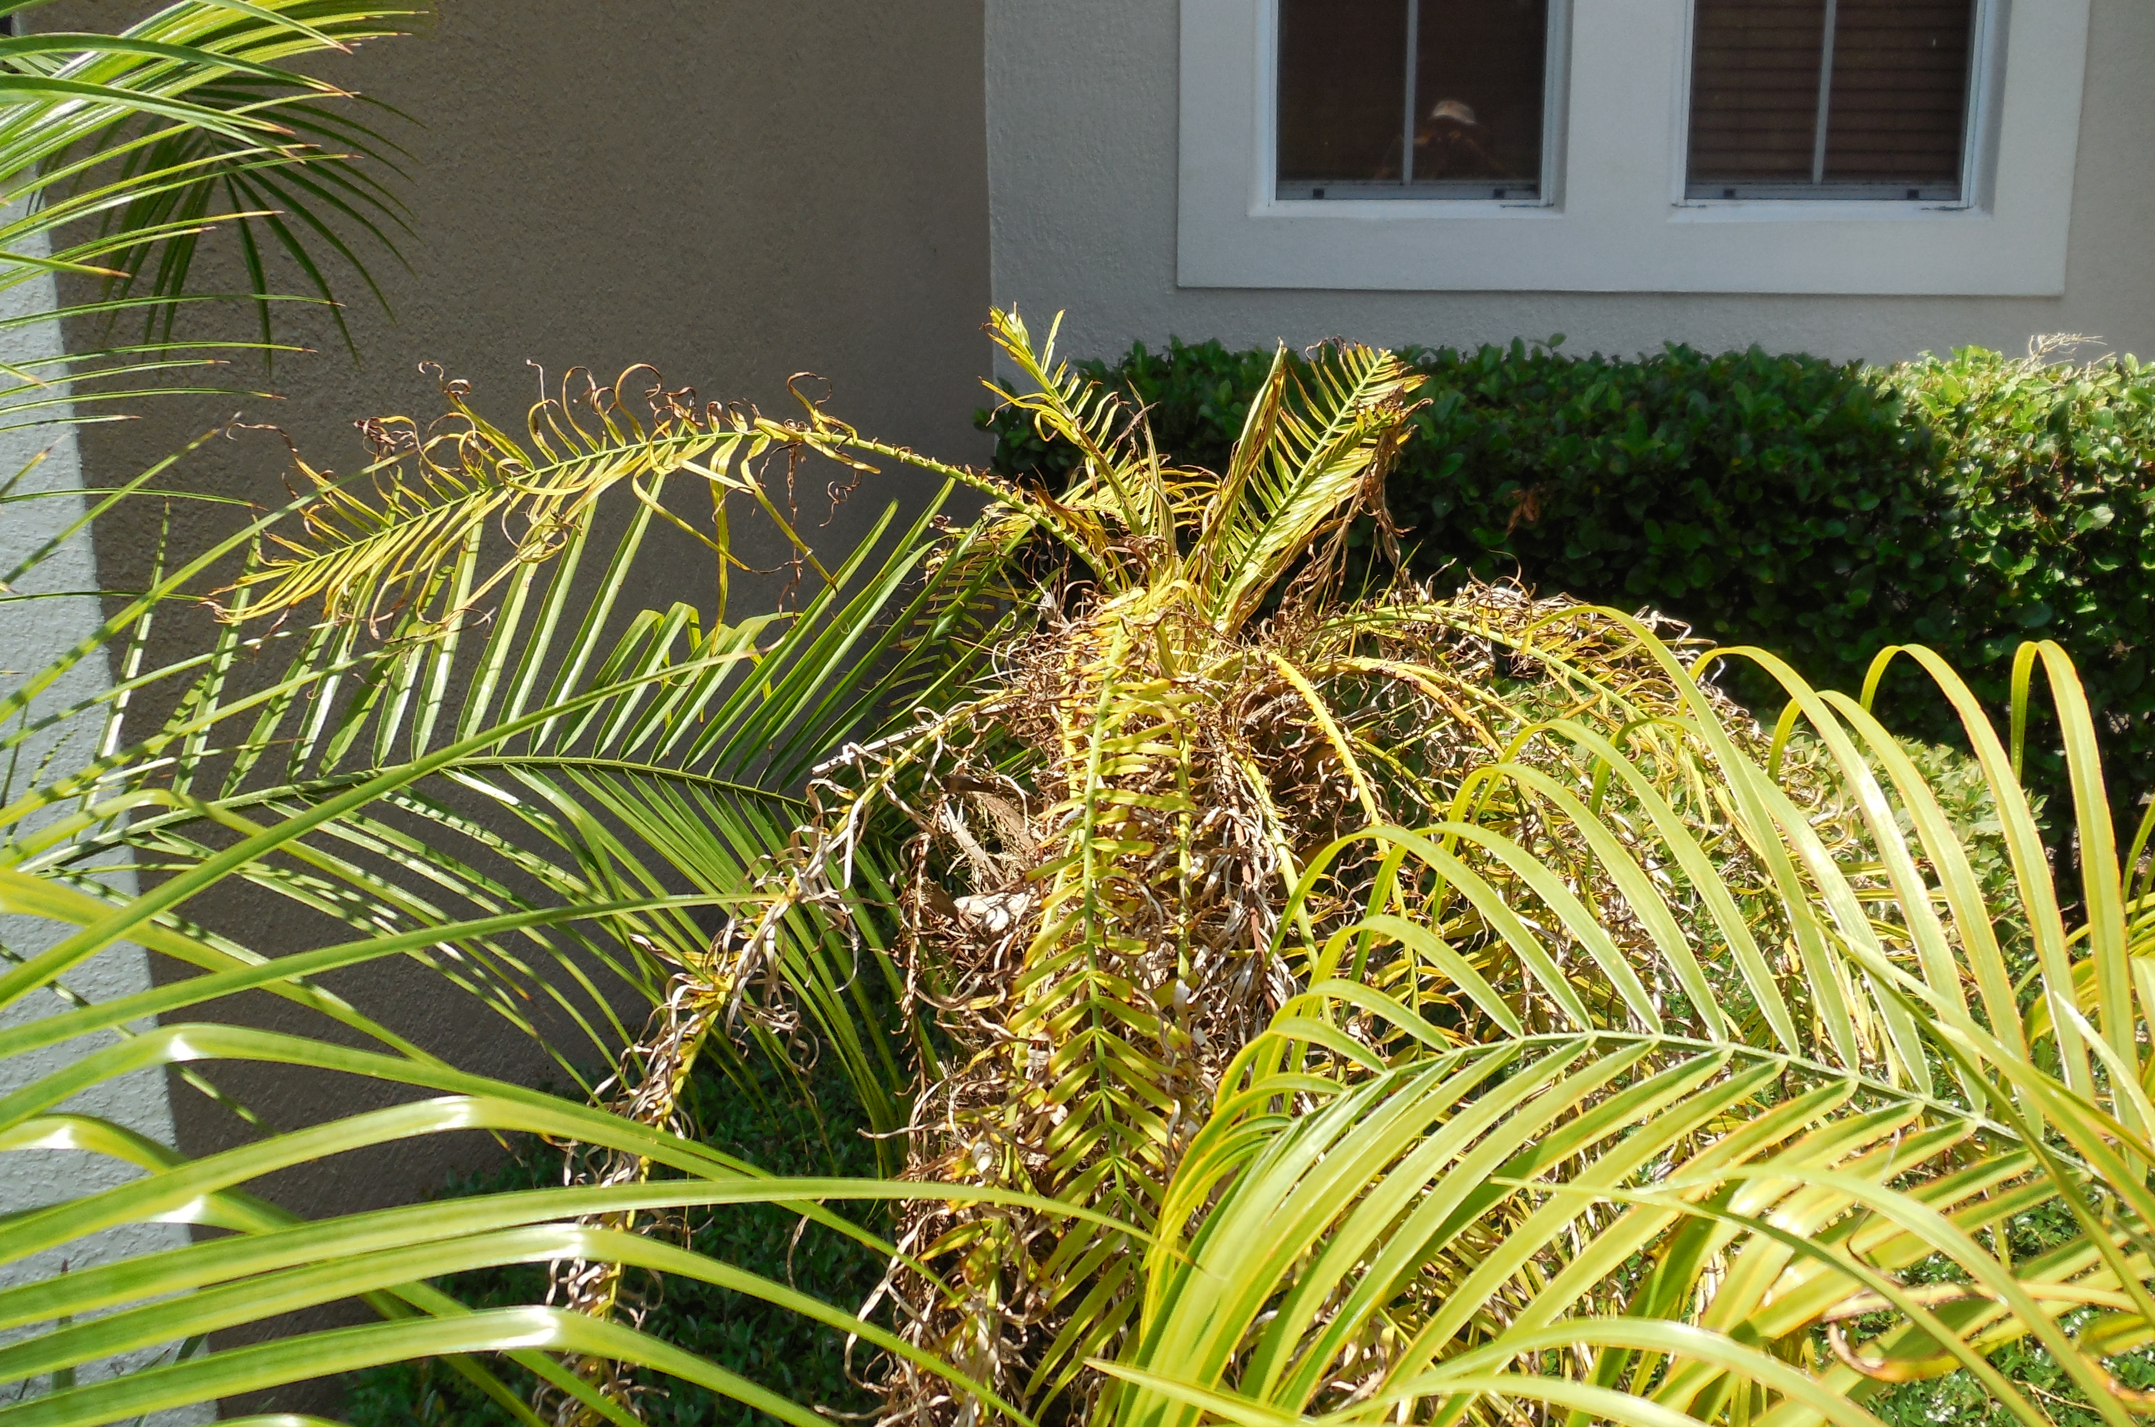
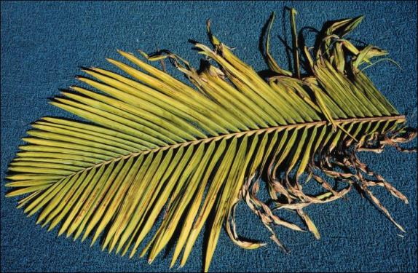
Manganese (Mn)
Symptoms
  Occurs on new fronds
  Leaflets emerge curled giving the palm a “frizzle-top” appearance
  Leaflets at the base of the frond are most affected resulting in a “V” pattern (opposite of Boron)
Treatment
  Apply Techmangam(2lbs) and 8-2-12(3-5lbs) every three months for 6 months
  Continue with 8-2-12 after 6 months

Slide 19
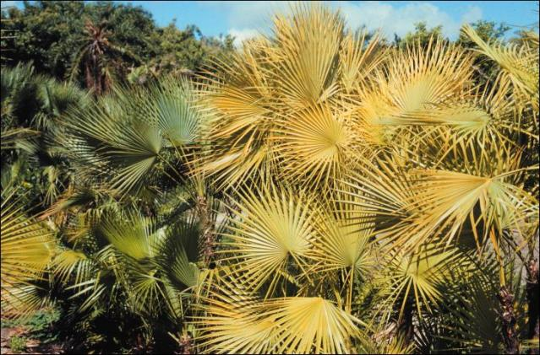
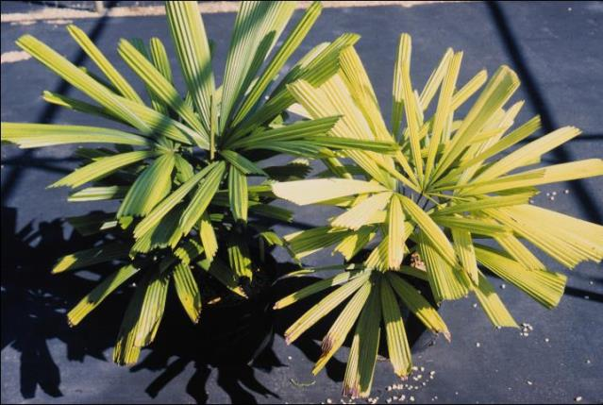
Iron (Fe)
Symptoms
  Occurs when soil conditions destroy the root system and prevent Fe uptake
    Saturated soils
    Planting too deep
  Begins with yellowing of new fronds and can progress until entire canopy is chlorotic
Treatment
  Fix site conditions to improve soil aeration
  Replant at proper depth

Slide 20
8-2-12 Palm Special
Recommended by University of Florida for all palm species
  Has the optimal ratio of nutrients
  All components are in a slow release form
Apply every 3 months for best results

