Slide 1
Welcome Condominium and Homeowners Association Board Members!

Slide 2
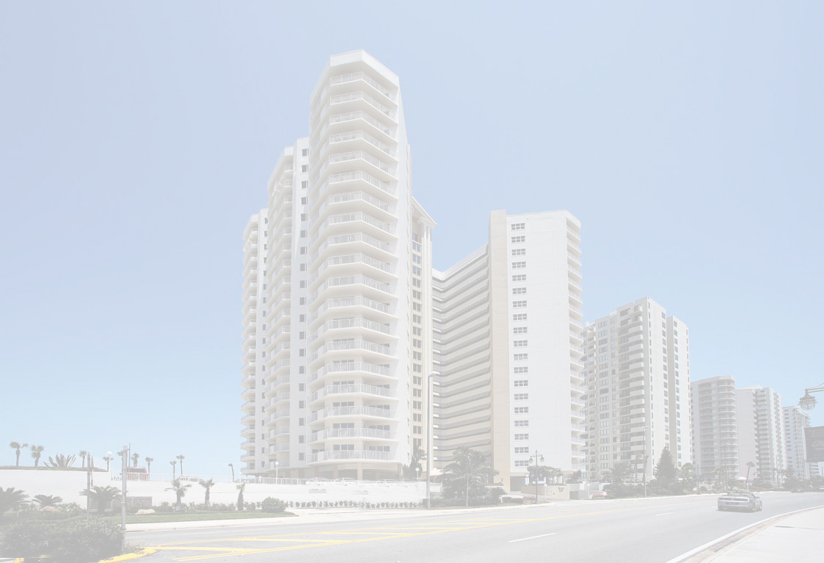
Evolution of Insurance Rates… Today’s Agenda
How We Got Here
Building Upkeep – Building Envelope
Building Values and Revisiting Appraisals
Changing Deductibles & Options
Roof vs Re-Roof vs Coating
Carrier Expectations for Legal Compliance
What about Citizens?
How can FCA help you, Q&A?

Slide 3
How We Got Here
Texas Ice Storm
Champlain Towers
Carrier insolvency, leaving market
Lawsuits against carriers, Multipliers
Assignment of Benefits
Fraud

Slide 4
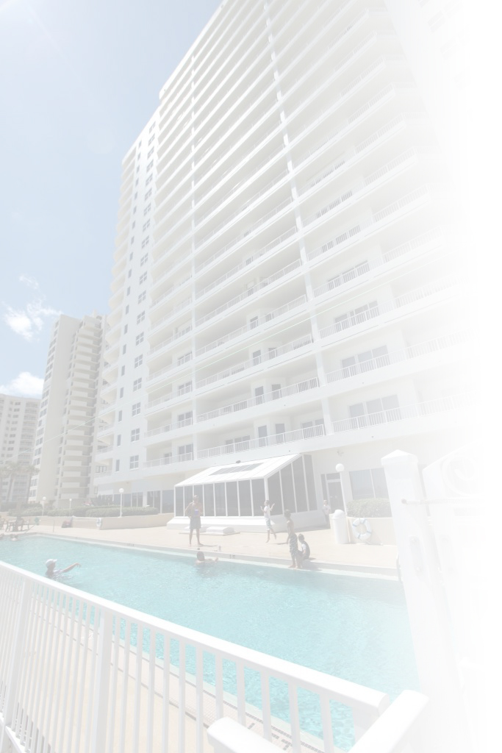
Building Upkeep
Unit Interior
Water Heater Replacement
A/C Line
Water Shut Off when unoccupied
Exterior Building
Balconies
Windows & Sliders
Concrete Restoration & Painting
Roof Maintenance & Replacement
Electrical, HVAC, Plumbing

Slide 5
Building Values and Revisiting Appraisals
State Statute requires new Replacement Cost Appraisal every 36 months
Cost of Construction/Materials
Flood vs Wind Values
Wind Mitigation Form
Sprinkler Monitoring Certificate

Slide 6
Changing Deductibles & Options
All Other Perils Deductible
Catastrophic Wind Deductible
All Other Wind Deductible
Equipment Breakdown Deductible
Water Damage Deductible
Ordinance & Law, Wind Driven Rain, Sewer Back Up Coverages

Slide 7
Roof vs Re-Roof vs Coating
Roof
Re-Roof
Coating

Slide 8
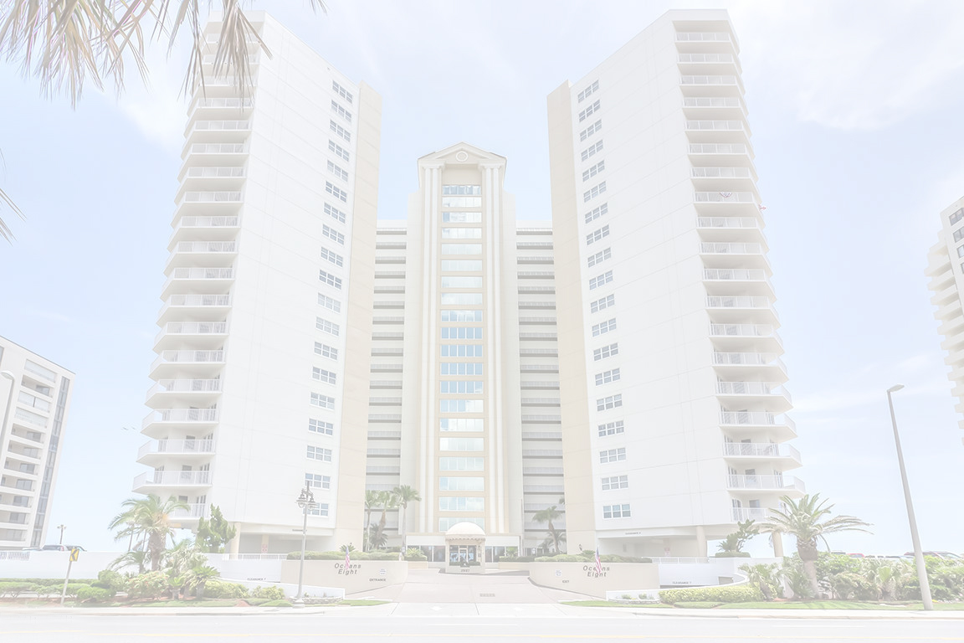
Carrier Expectations
Engineering Study within 5 years
Roof Replacement 15 years
HVAC, Electrical, Plumbing Updates with documentation 20 years
Undesirable Features - Aluminum Wiring, Chinese Drywall, EIFS, Cast Iron Pipes, Galvanized Pipes, Polybutylene Pipes
Appraisals ahead of 36 months
Citizens

Slide 9
What About Citizens?
Place in the market
Submission requirements
Time frames

Slide 10
How can FCA help? Any Questions?

Slide 11
Thank You for the opportunity to provide you with this important information!

