Slide 1
Disaster Preparedness
Before, During and After A Look Back at 2022
A Look Ahead at 2023

Slide 2
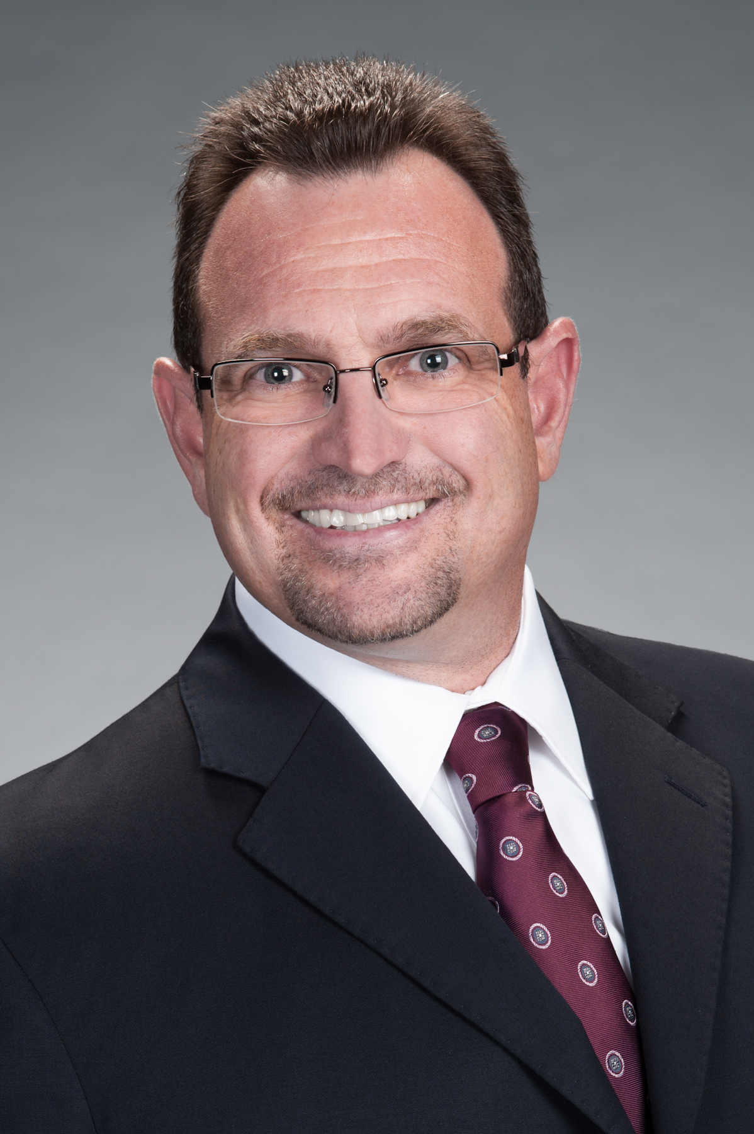
John Carr, HCI-C, HCI-R, HCI-W
Storm Restoration Expert
John Carr Vice President of the Restoration division of R&R Industries, a commercial contractor headquartered in central Florida since 1948.
Widely recognized for his restoration expertise, Carr brings many years of experience, having worked on major projects throughout the state including Hurricanes Matthew, Irma and Michael to name a few.
John assists his clients by managing the insurance claim process and putting together a team of experts to ensure that your property is restored properly and receive what is rightfully owed to them by the insurance company.
A HAAG Certified Inspector John possess the resources to assess your property or damaged Property effectively and with confidence.

Slide 3
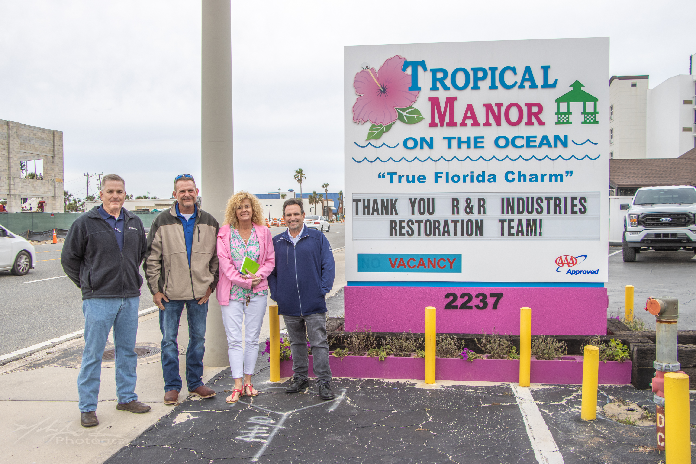
R&R Industries, Inc
Established 1948
Headquarters in Holly Hill
Veteran Owned
Roof Maintenance
Roof Repairs
Roof Replacements
Renovations
24 Hour Emergency Services
Building Repairs
Insurance Claim Consulting
Post/Pre Storm-Damage Assessments
Gutter Replacement/Repair
Interior Repairs/Renovations
Pressure Washing & Cleaning
John Carr Vice President of R&R Industries, a commercial contractor headquartered in central Florida since 1948.
Widely recognized for his restoration expertise, Carr brings many years of experience, having worked on major projects throughout the state including Hurricanes Matthew, Irma and Michael to name a few.
John assists his clients by managing the insurance claim process and putting together a team of experts to ensure that your property is restored properly and receive what is rightfully owed to them by the insurance company.
A HAAG Certified Inspector John possess the resources to assess your property or damaged Property effectively and with confidence.

Slide 4
A Look Back at 2022
Are You Ready for 2023

Slide 5
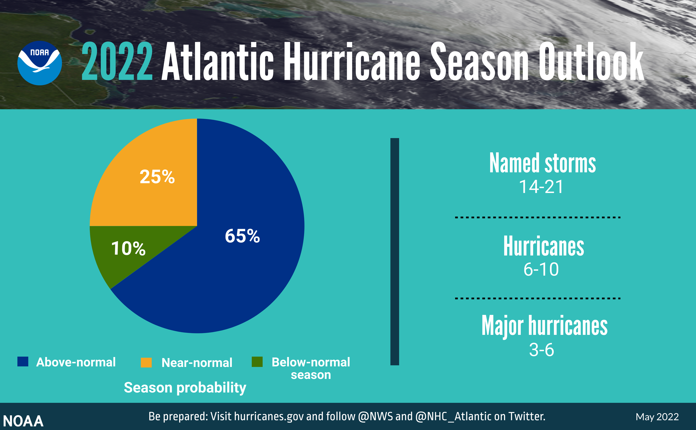
Notes:
Quick review and update with new information for 2021

Slide 6
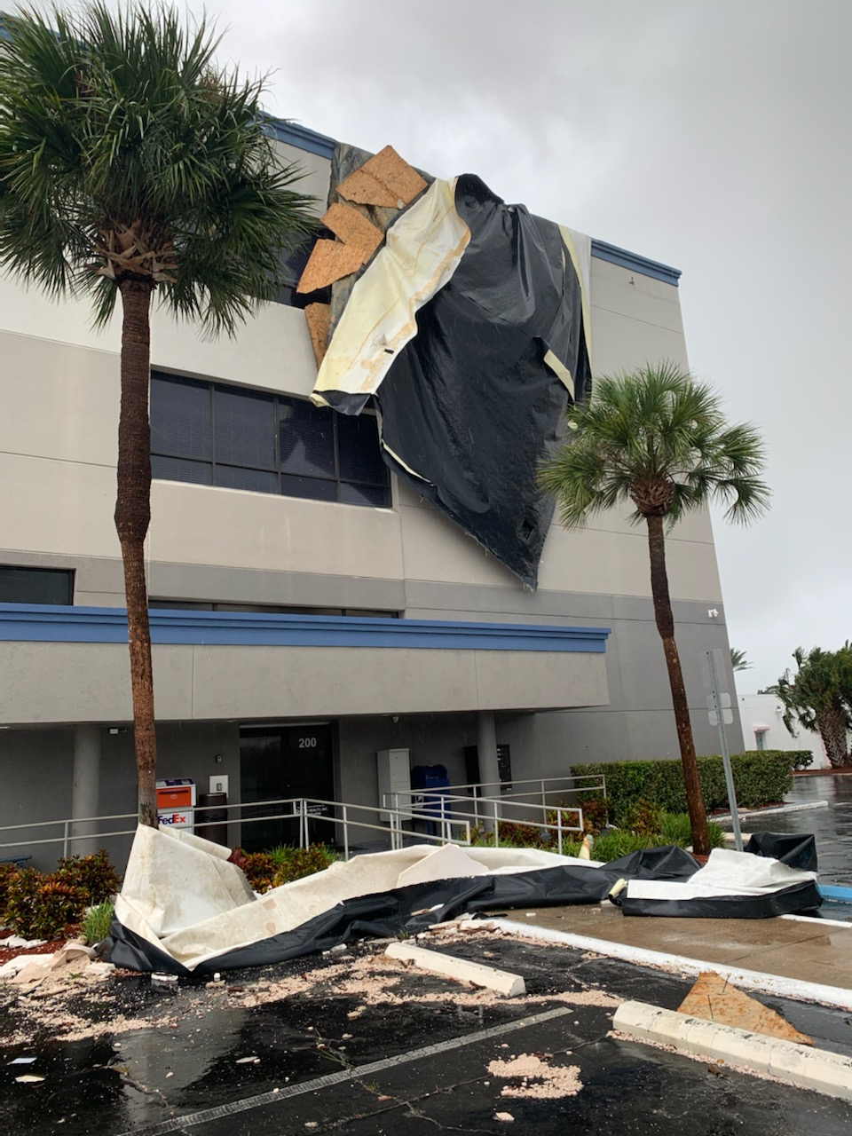
2022 Hurricane Season
Total Storms 14 – Forecasted - 14-21
Hurricanes 8 – Forecasted – 6-10
Major Hurricane 2 – Forecasted – 3-6

Slide 7
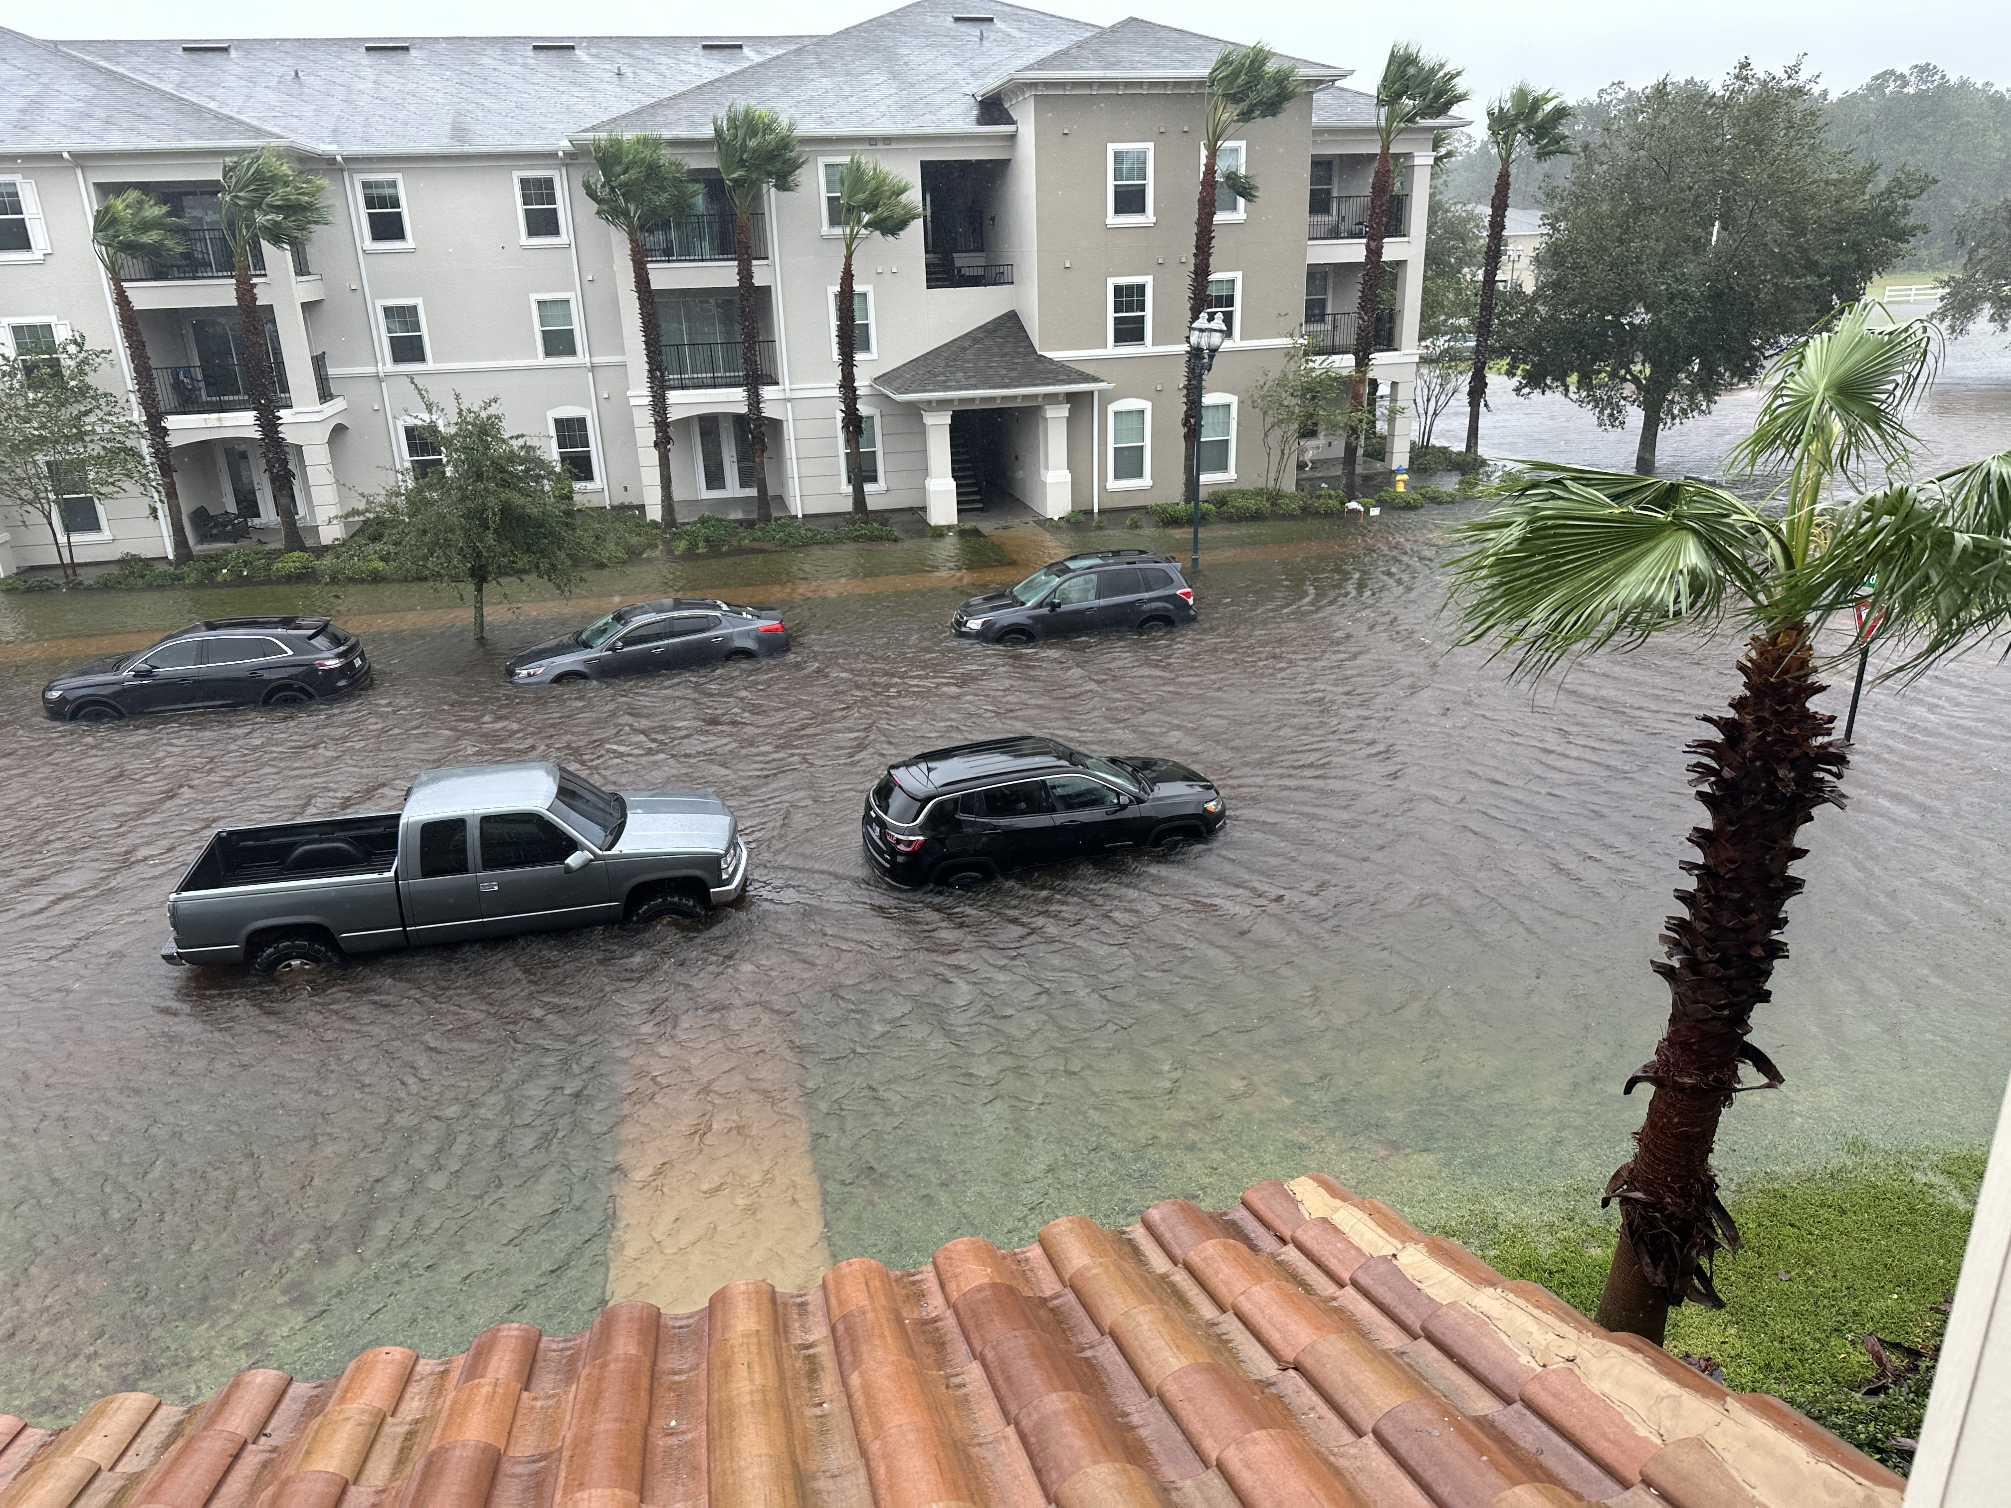
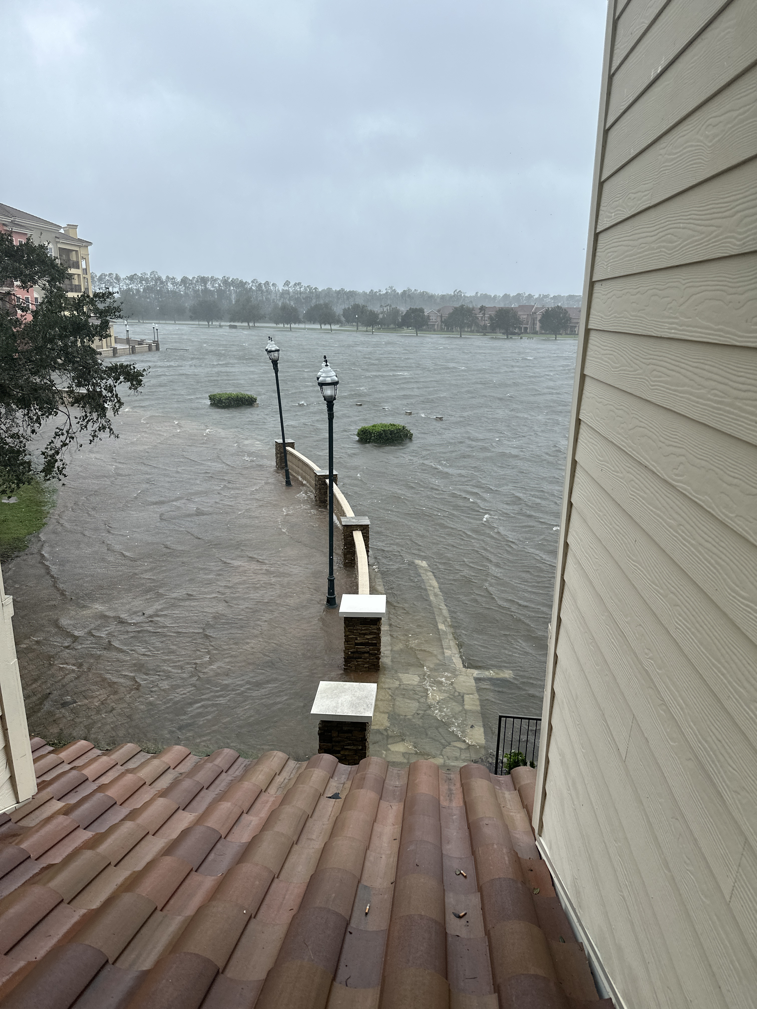
2022 Hurricane Season

Slide 8
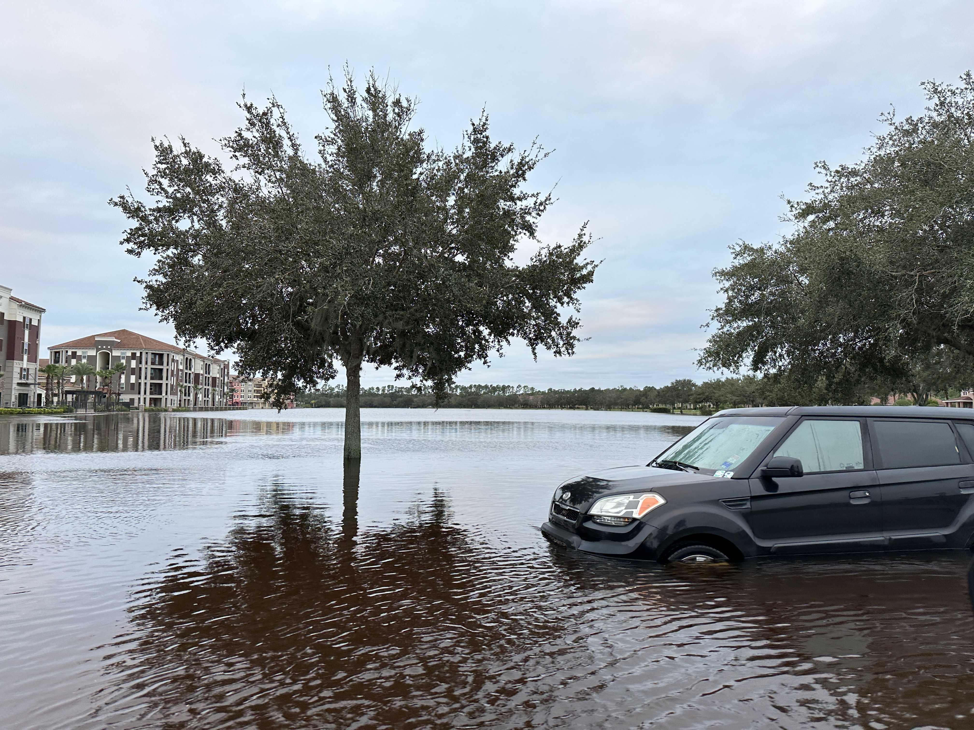
2022 Hurricane Season

Slide 9
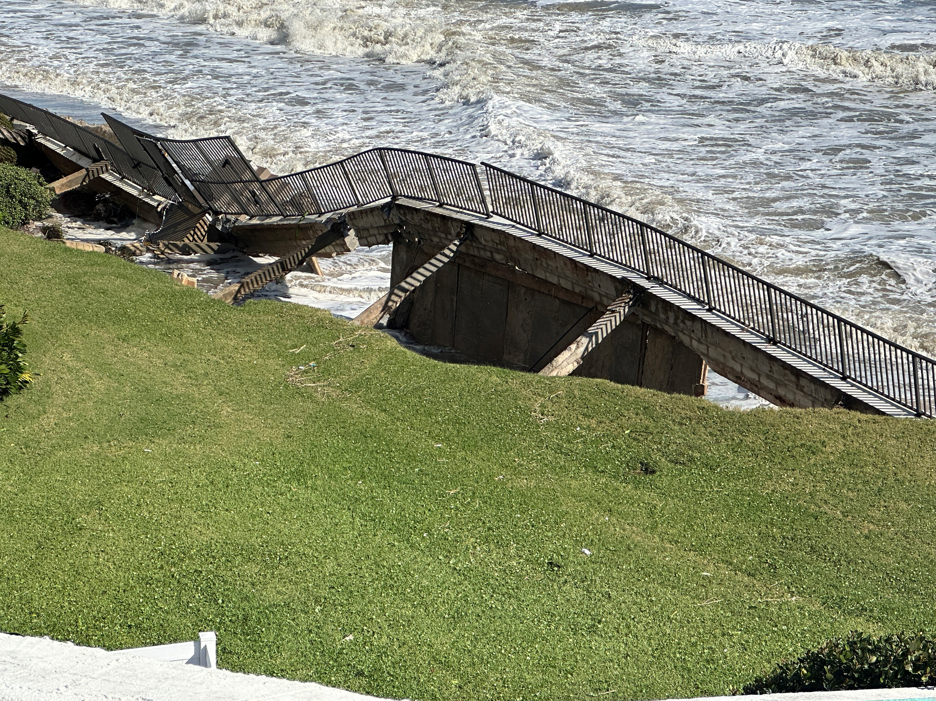
2022 Hurricane Season

Slide 10
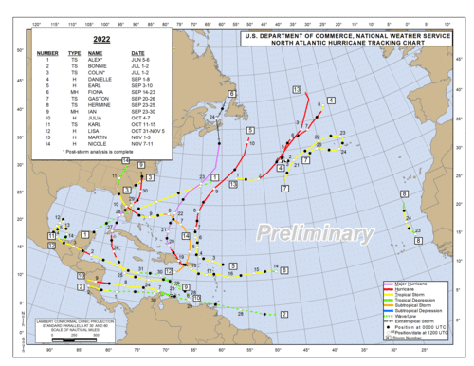
Notes:
Quick review and update with new information for 2021

Slide 11
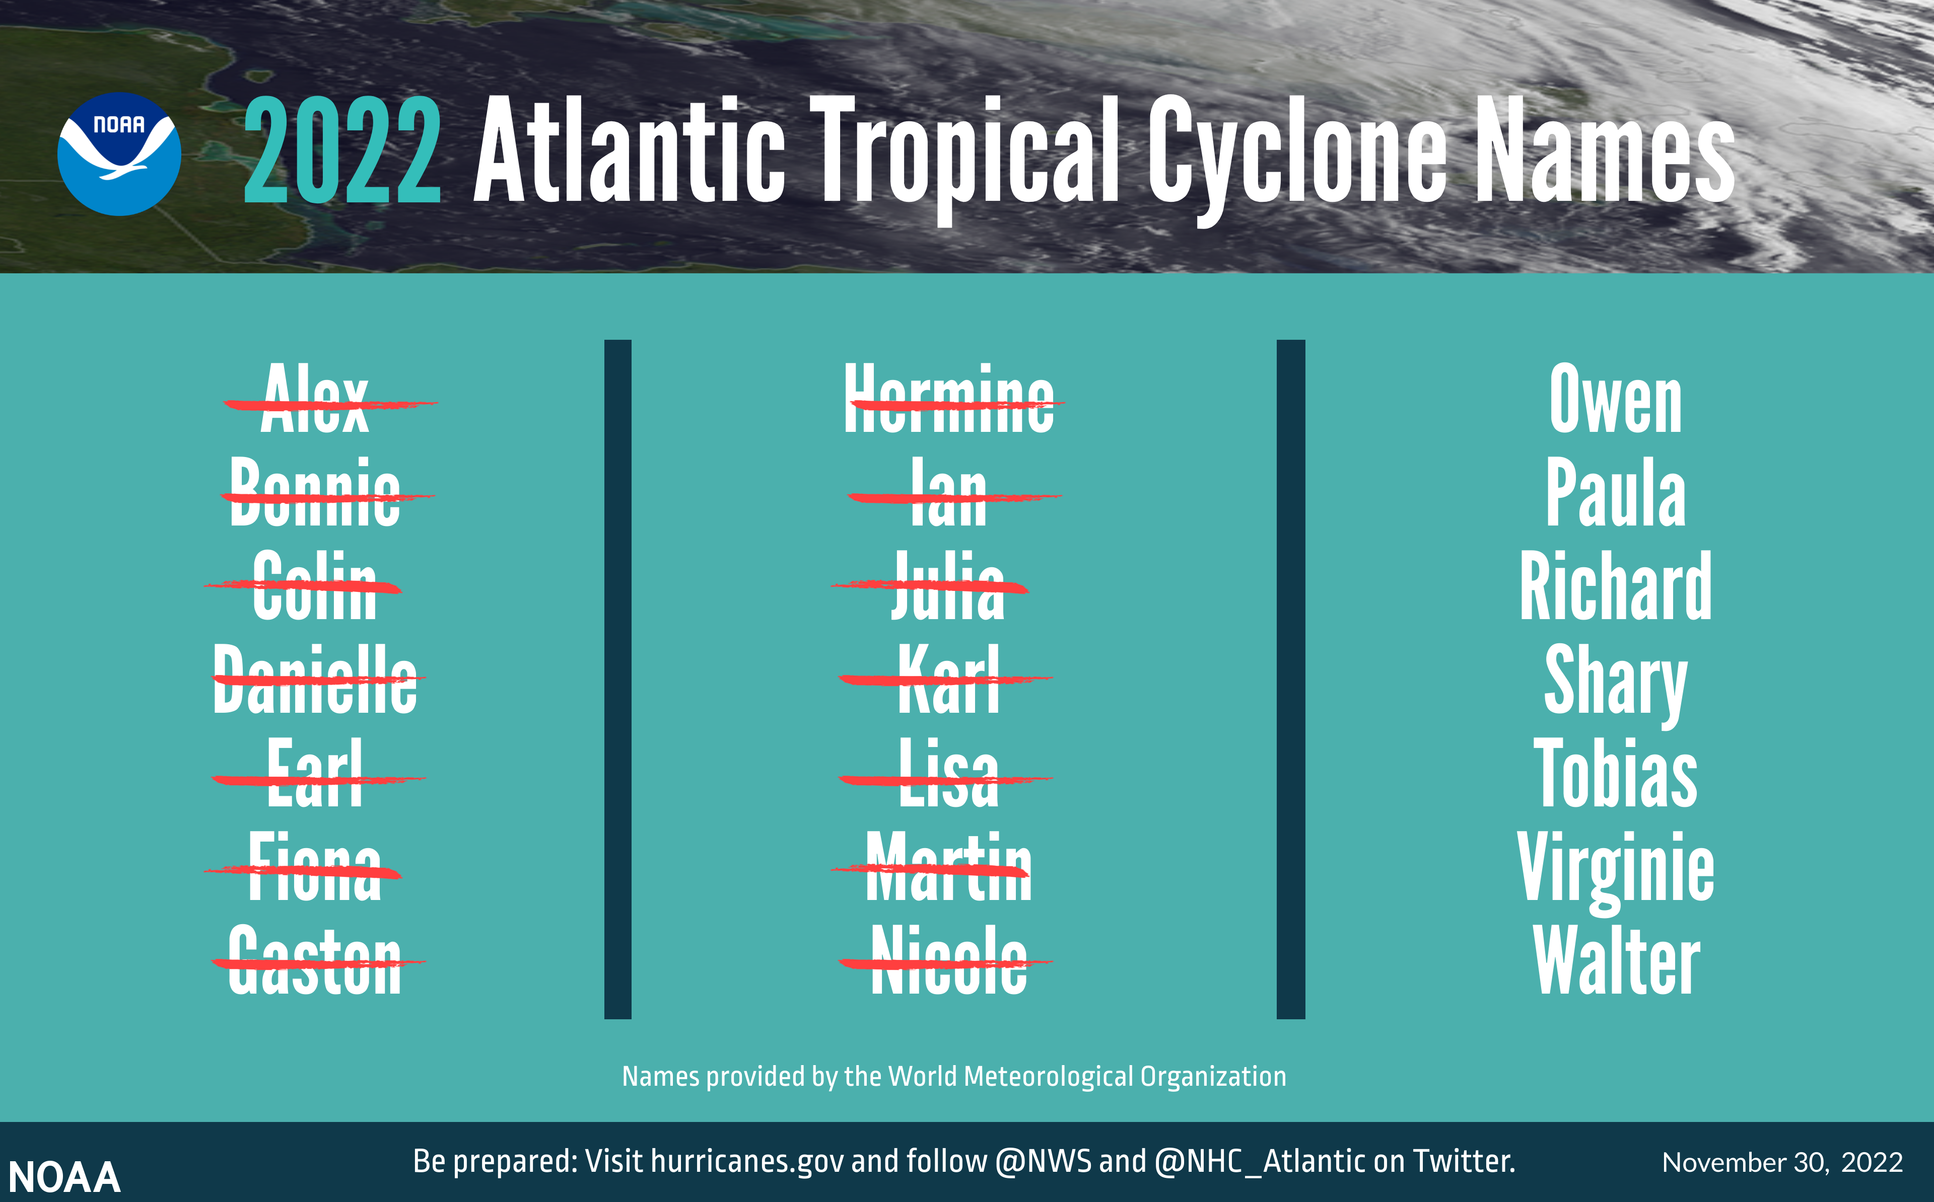
Notes:
Quick review and update with new information for 2021

Slide 12
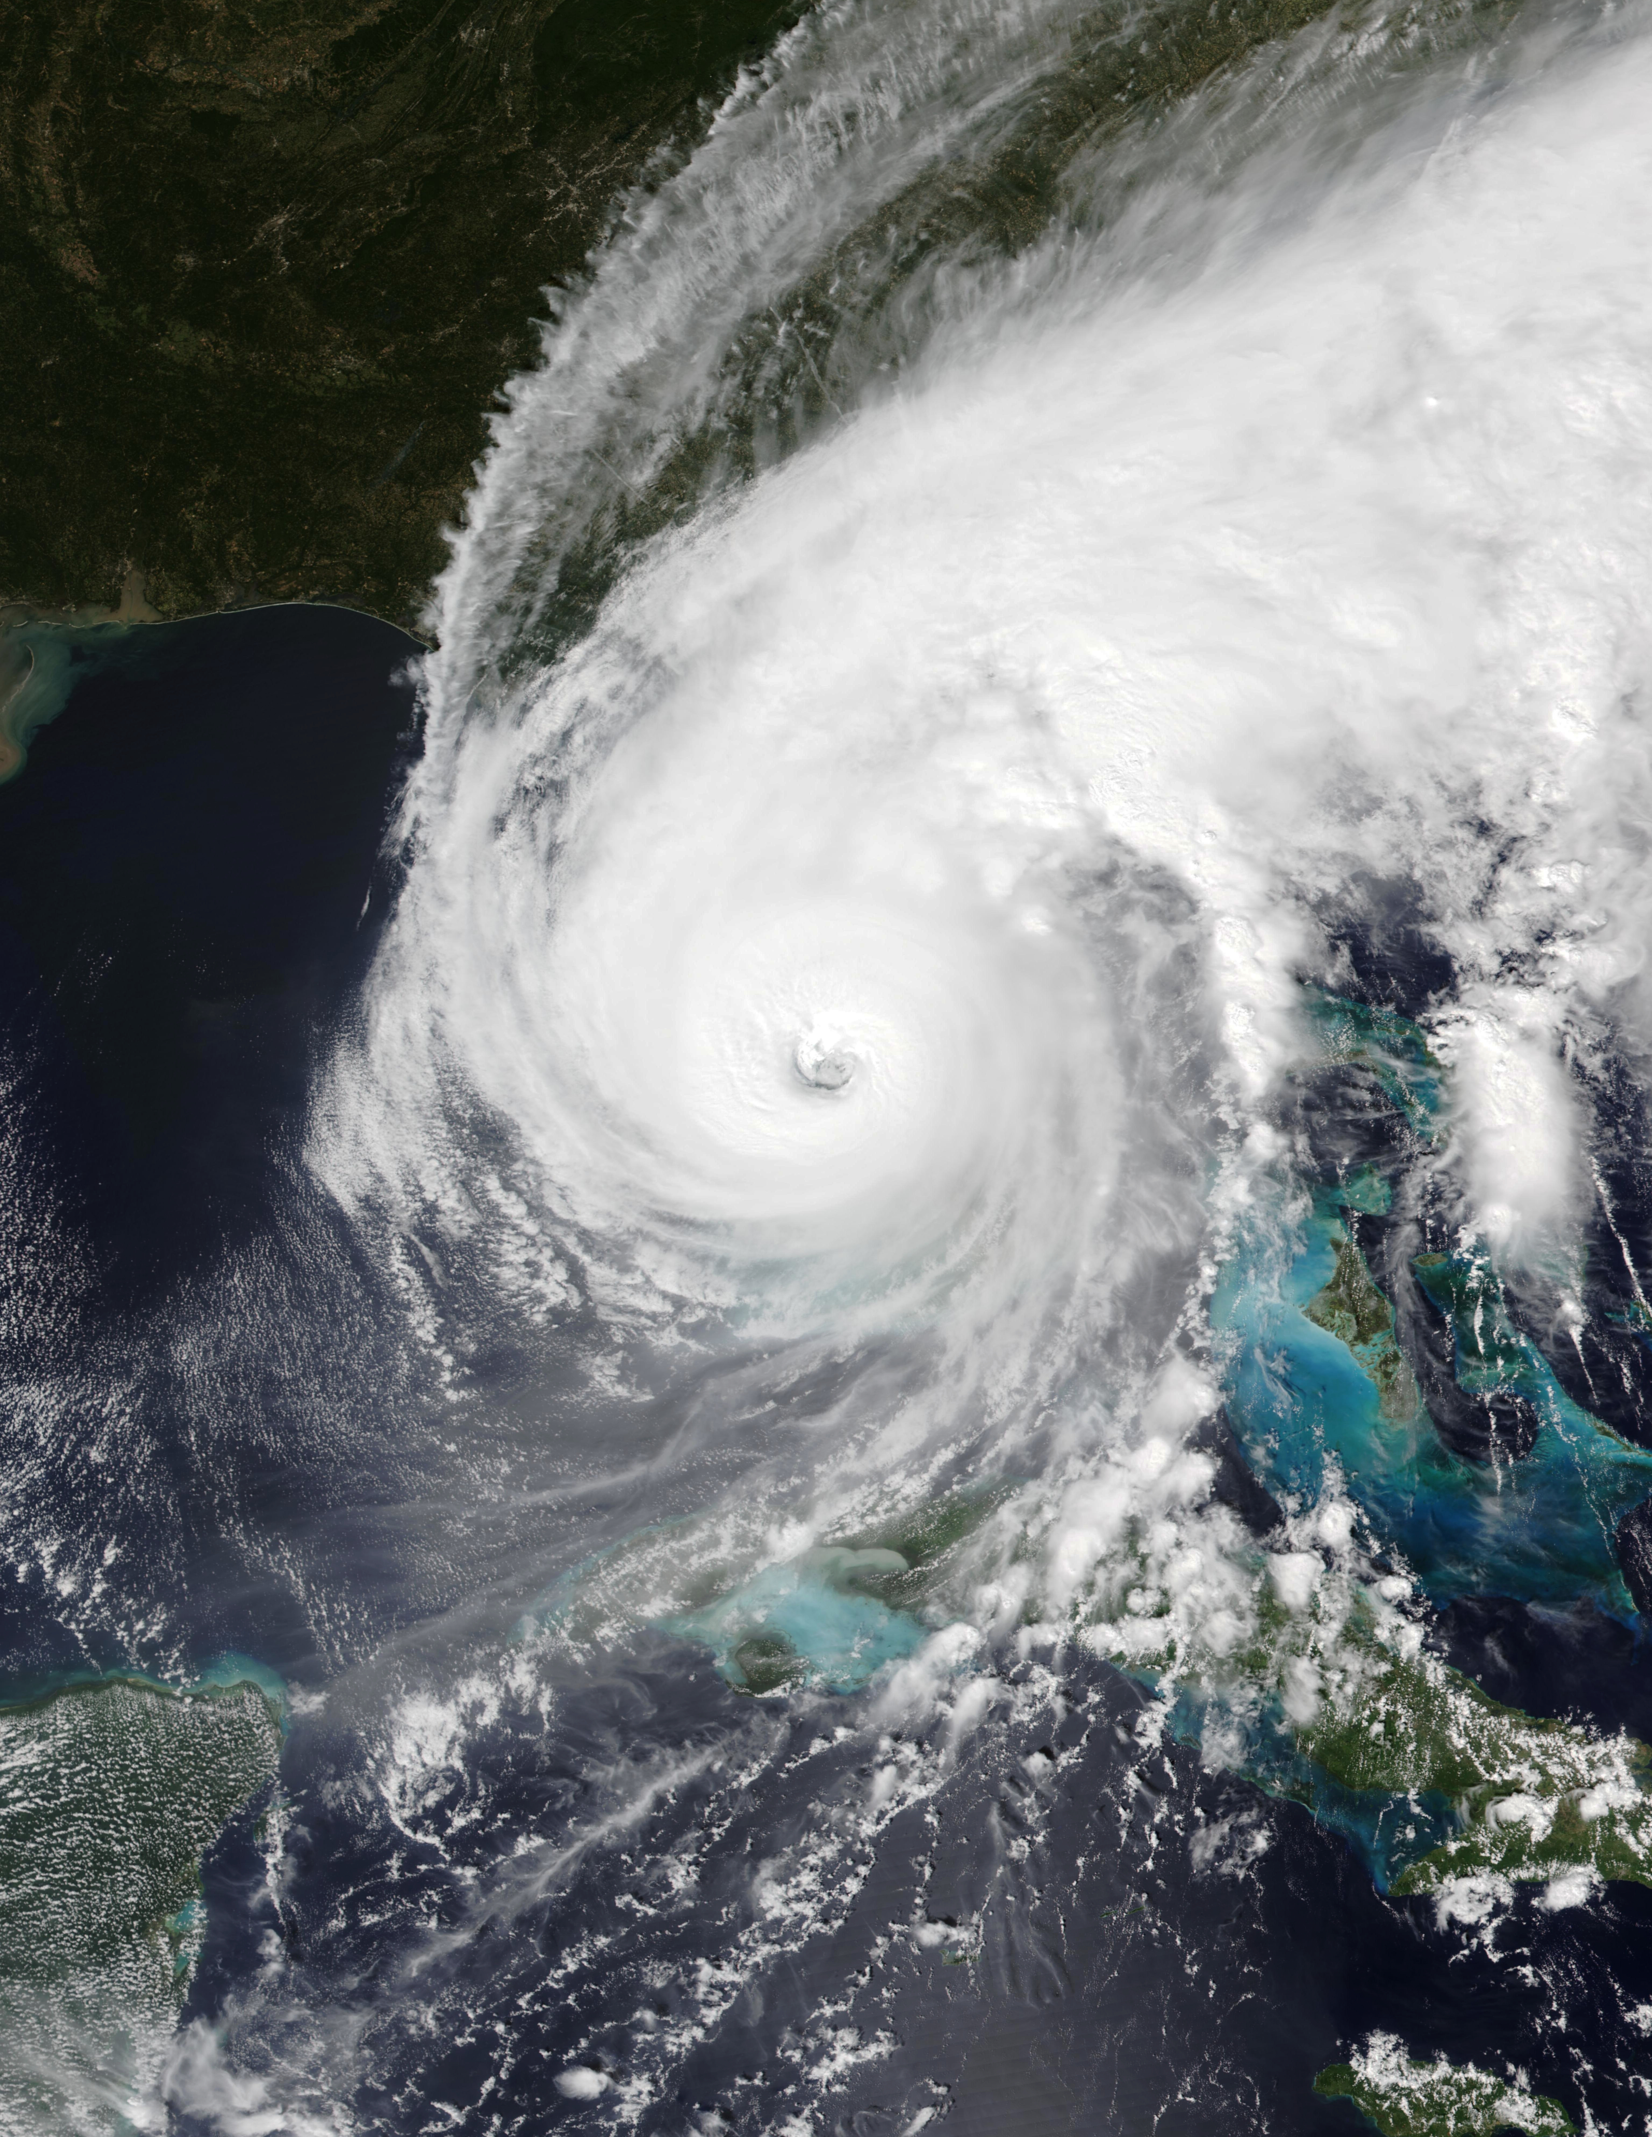
2023 Forecasted Hurricane Outlook
Named Storms - 14-18
Hurricanes – 7- 9
Major Hurricane 2 – 4
Official Forecast Comes in Mid May

Slide 13
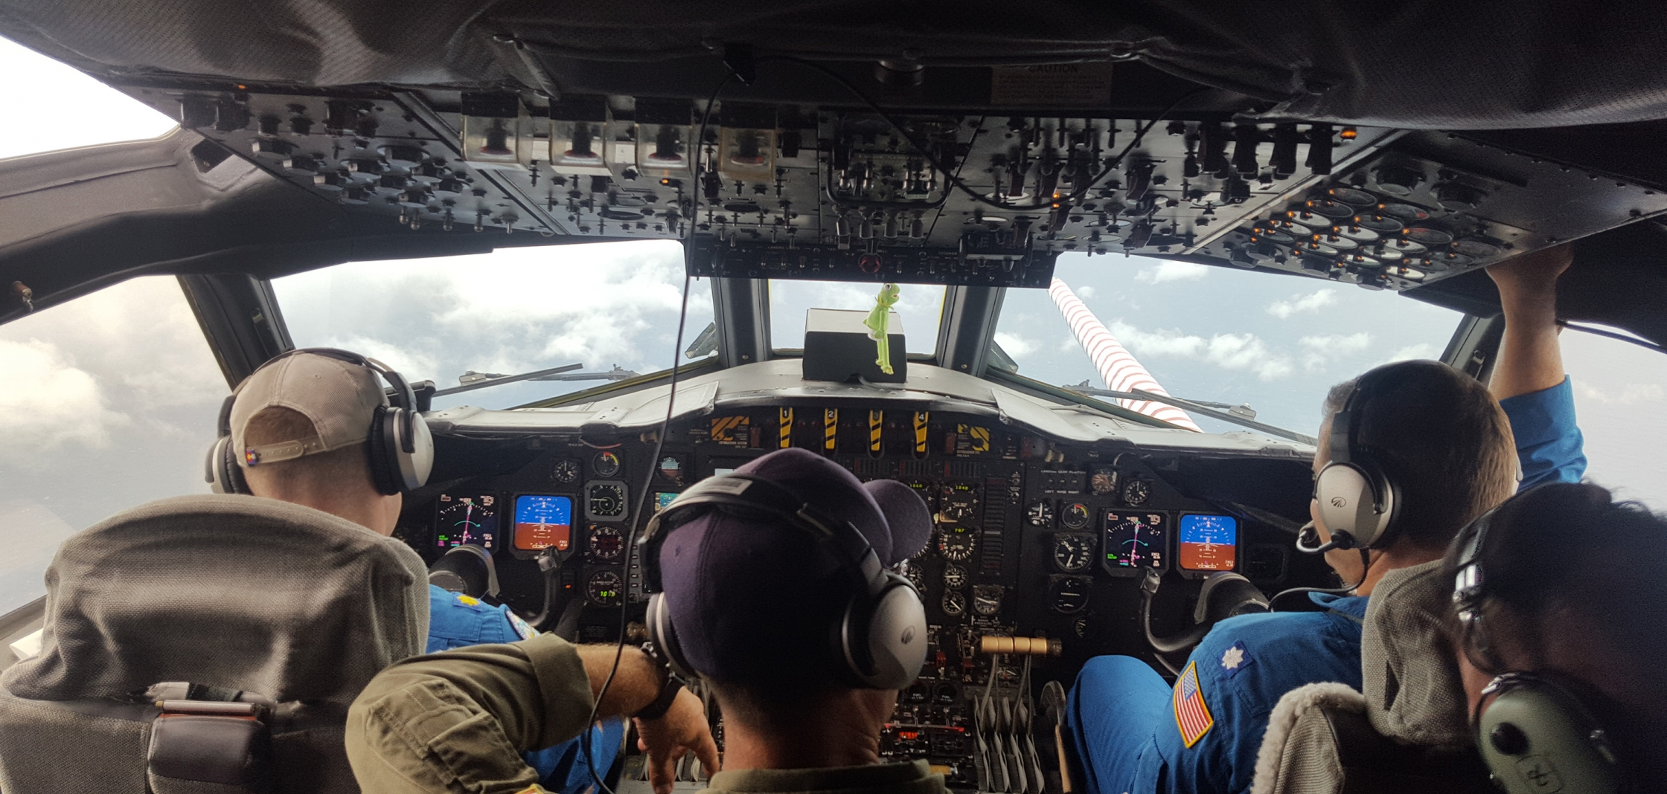
Hurricane Hazards
Extreme Winds
Storm Surge
Inland Flooding
Tornadoes
Post Storm Injuries
The flight deck of NOAA Lockhead WP-3D Orion N42RF Photo Courtesy of NOAA

Slide 14
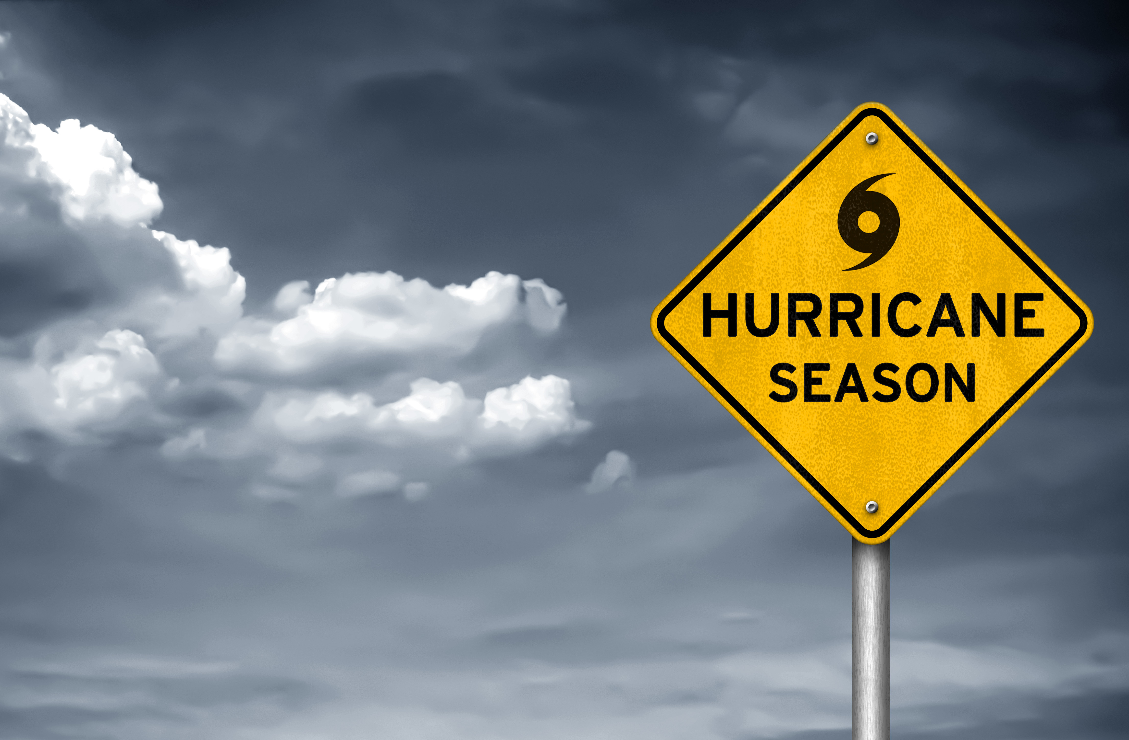
Be Ready! Before a Storm Strikes
Know your risk! Find out if you are in a flood zones etc. Make sure to know evacuation plans and routes.
Insurance Policy Review and Check Up
Pre-Storm Property Assessment
Flood zones and how they impact you
Develop an association emergency plan and possibly name an emergency coordinator – including evacuation plan
Secure your property
Pre-Storm Emergency Repair Contracts and/or Contacts
Have all your supplies ready 3 days prior to storm
Notes:
Review each line and go into detail of how to achieve these.

Slide 15
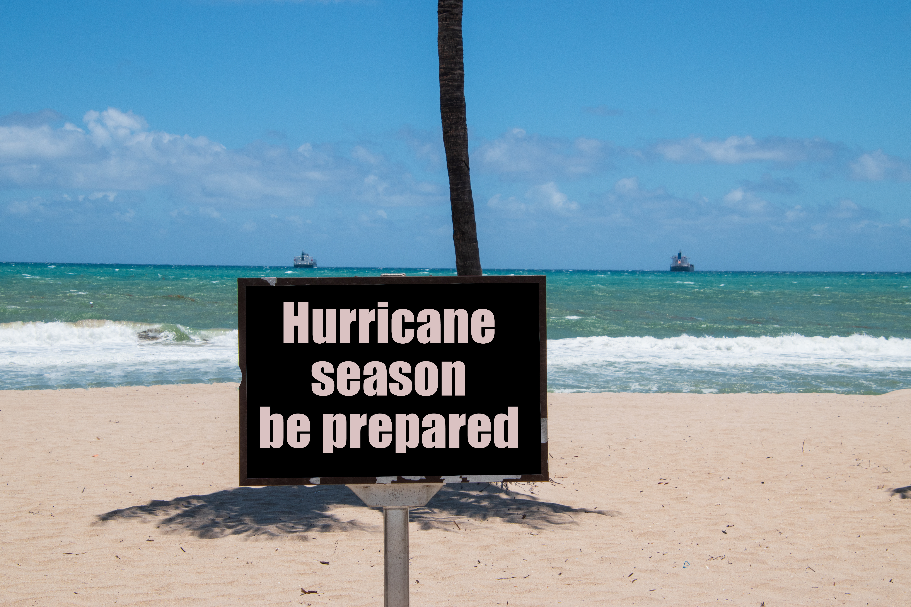
Be Ready! During the Storm
Stay informed by listening to authorities and make sure you are aware of developing events.
Stay indoors and remember during hurricanes the eye of the storm may come across your location and the seemingly safe conditions may tempt you to venture outside. Be careful!
Have battery operated radio and lights.
Evacuate if you are in an evacuation zone
Notes:
Review each line and go into detail of how to achieve these

Slide 16
Be Ready! After the Storm
Stay informed by listening to authorities and make sure you are aware of developing events.
Immediate Dangers:
Flooding
Downed Powerlines
Hanging trees and debris from building
Displaced wildlife
Contact your contractor for full assessment and any emergency repairs
Notify local emergency management of damages
Notes:
Review each line and go into detail of how to achieve these

Slide 17
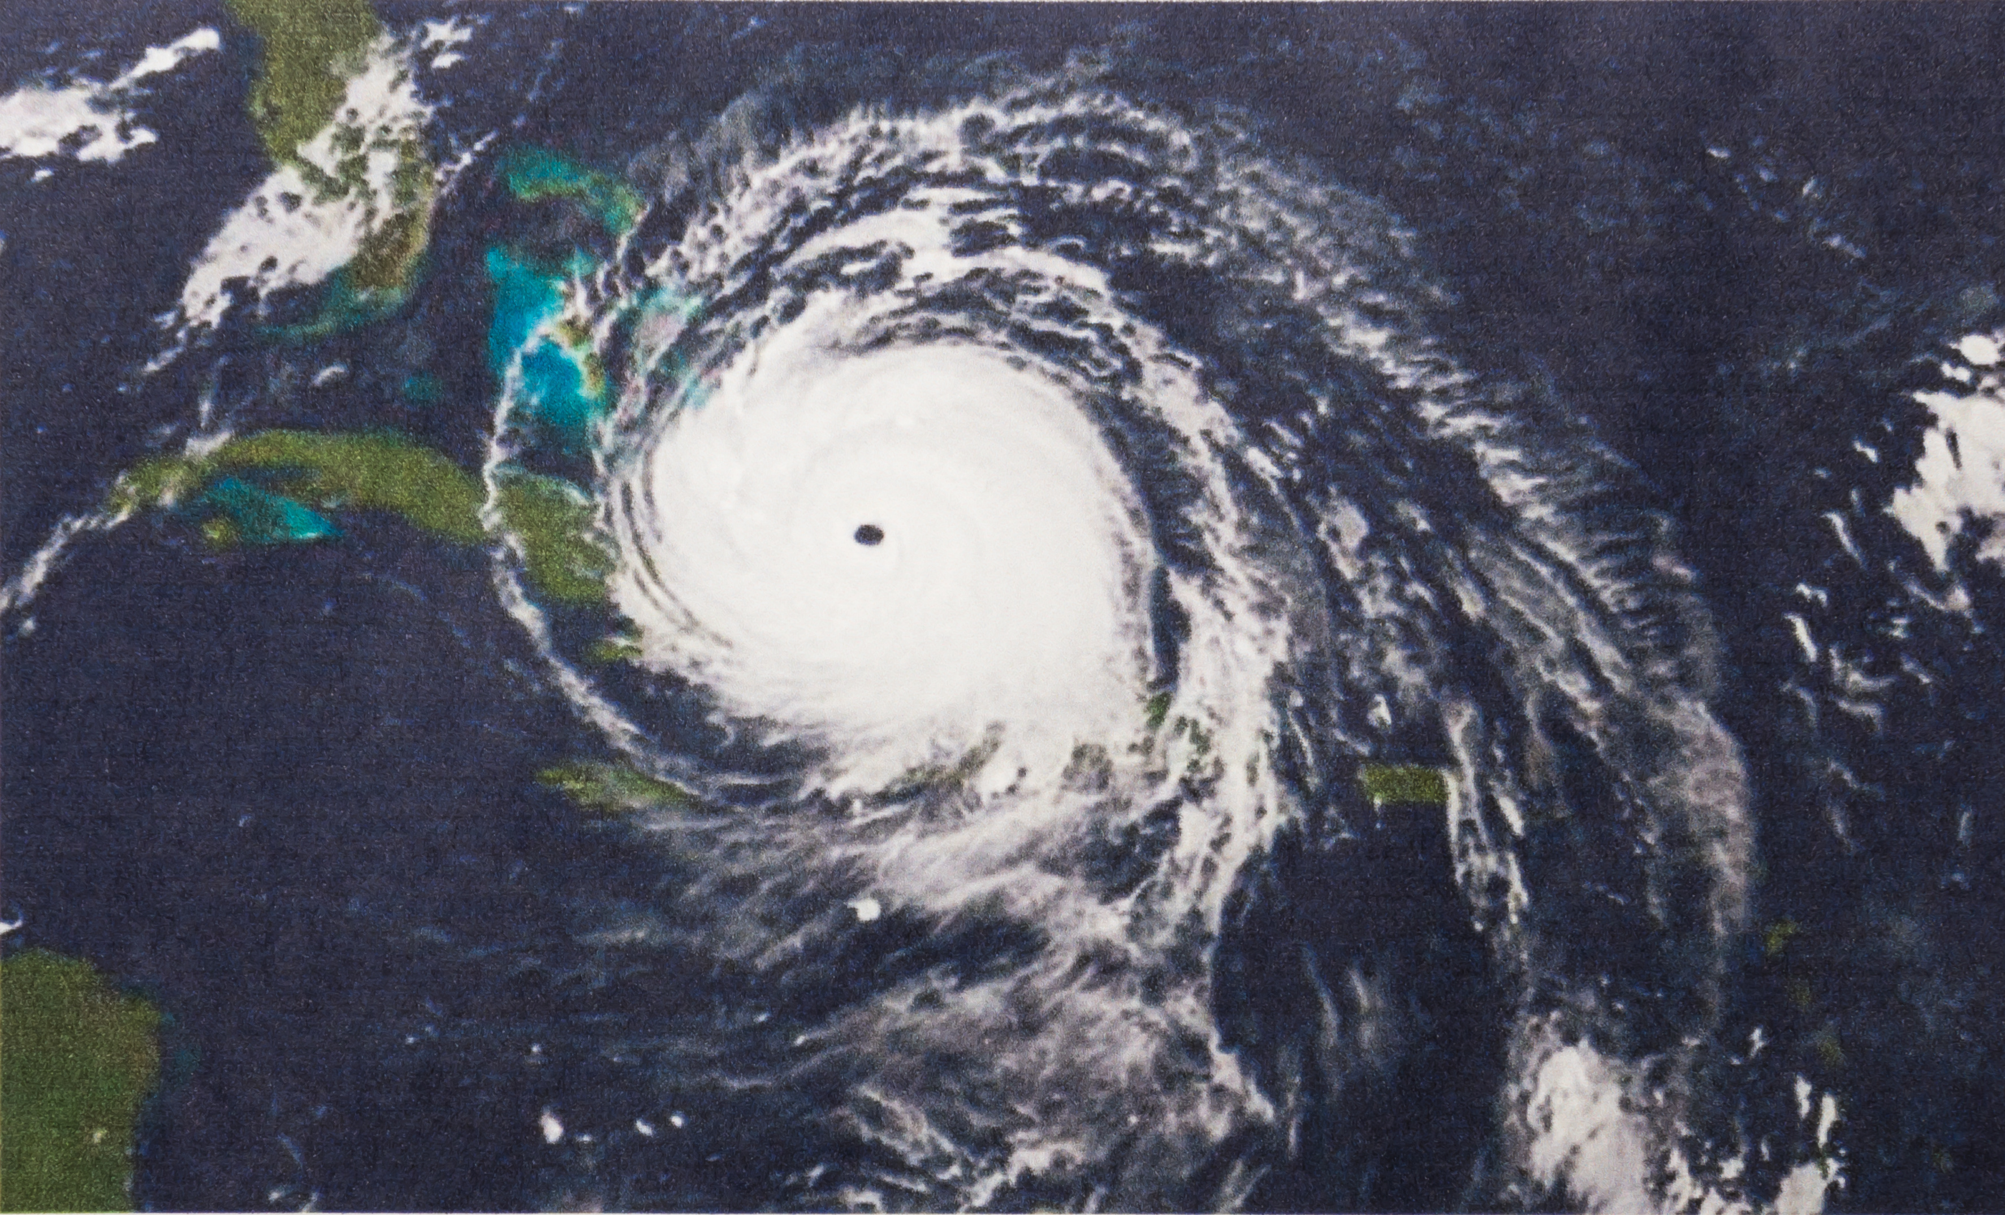
Association Emergency Plan
Insurance and Emergency Repairs
Insurance Policy: Things to consider
Coverages such as other structures, debris clean up, tennis courts etc.
Law and Ordinance Coverages
Deductibles – know the % and prepare
Exclusions – Identify these prior to storm season
Funding:
Have deductible in reserves
Know exclusions of policy and have funding for repairs
Have emergency/temporary repair fund
Notes:
Review bullets

Slide 18
Q&A
C
CONTACT INFORMATION:
JOHN CARR – 386-253-7627 Ext. 310 EMAIL – john@rrifl.com
CAROLYN BRAMAN - 386-253-7627 Ext. 320 EMAIL – Carolyn@rrifl.com

